Slide 1
MAKE TODAY COUNT:
THE SECRET OF YOUR SUCCESS IS DETERMINED BY YOUR DAILY AGENDA

Slide 2
Objective
“Daily Dozen”
Making the Decision
Managing the Discipline

Slide 3
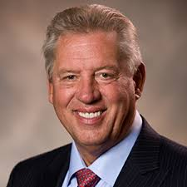
John C. Maxwell
Leadership expert, pastor, speaker, and Business Week and New York Times bestselling author.
Has written many books, primarily focusing on leadership and his books have sold millions of copies.
Dr. Maxwell is the founder of EQUIP and INJOY Stewardship Services.

Slide 4
"Make EVERY DAY Your MASTERPIECE!"
https://www.youtube.com/watch?v=ntLjk8vELCA&t=408s

Slide 5
The “Daily Dozen”: Making the Decision
“You don’t make decisions because they’re EASY;
You don’t make decisions because they’re CHEAP;
You don’t make decisions because they’re POPULAR;
You make decisions because they’re RIGHT.”
Theodore Hesburgh

Slide 6
Making the Decision
Attitude: Choose and display the right attitude daily.
Take responsibility and charge for your attitude.
Decide to change your bad attitude areas and go after those areas.
Think, act, talk, and conduct yourself like the person you want to become.
Place a high value on people.
Develop a high appreciation for life and acknowledge the little things.

Slide 7
Making the Decision
Priorities: Determine and act on important priorities daily.
Prioritize your life and give focus and energy to those things that give the highest returns.
Ask yourself three questions:
What is required of me?
What gives me the greatest return?
What gives me the greatest reward?
Stay in your strength zone:
Trial and error:
The counsel of others:
Personality tests:
Personal experience:

Slide 8
Making the Decision
Health: Know and follow healthy guidelines daily.
Have a purpose worth living for.
Having a sense of purpose
Do work you enjoy.
Do work that adds value to yourself and others.
Find your pace.
Maintain a healthy pace of life that is right for you.
Accept your personal worth.
Laugh

Slide 9
Making the Decision
Family: Communicate with and care for my family daily.
Determine your priorities.
Never neglect or abandon family for fame, status, or financial gain.
Decide on your philosophy.
Develop your problem-solving strategy.
Promotes better understanding, positive change, and growing relationships.

Slide 10
Making the Decision
Thinking: Practice and develop good thinking daily.
Understand that great thinking comes from good thinking.
Recognize there are many kinds of thinking.
Big picture thinking
Focused thinking
Creative thinking
Realistic thinking
Strategic thinking
Possibility thinking
Reflective thinking
Questionnaire popular thinking
Shared thinking
Unselfish thinking
Bottom-line thinking

Slide 11
Making the Decision
Commitment: Make and keep proper commitments daily.
Count the cost.
Strengthens one’s commitments
Determine to pay the price.
Are you willing to do what it takes to follow through?
Always strive for excellence.
Always do your best in everything you do.
Make sure to check your work and the details.

Slide 12
Making the Decision
Finances: Make and properly manage dollars daily.
Put the value of things into perspective.
Recognize your season of life.
Learn
Earn
Return
Reduce your debt.
Put your financial formula into place.

Slide 13
Making the Decision
Faith: Deepen and live out my faith daily.
Understand that faith is often birthed out of difficulties.
Can help you through a crisis.
Approach life with a whole new perspective.
Adopt an outlook of hope and courage.
A faith that hasn’t been tested can’t be trusted.
Deepen your faith.

Slide 14
Making the Decision
Relationships: Initiate and invest in solid relationships daily.
Place a high value on people.
Expect the best from everyone.
Learn to understand people.
Build positive relationships.
Give respect freely but expect to earn it from others.
Give people the utmost respect you expect in return.
Commit yourself to adding value to others.

Slide 15
Making the Decision
Generosity: Plan for and model generosity daily.
Give others your money.
The more you give, the more you learn to care about others.
Give others yourself.
Give others your time and attention.
“No man becomes rich unless he enriches others.” - Andrew Carnegie

Slide 16
Making the Decision
Values: Embrace and practice good values daily.
Create a list of good values.
Eliminate anything that is superficial.
Have common values.
Embrace those good values.
Make a decision to live those values daily.
Focus on the important things.
Manage life according to your values.
Review and reflect on each of the Daily Dozen.

Slide 17
Making the Decision
Growth: Seek and experience improvements daily.
Answer the question: What is my potential?
Commitment to maximize your potential.
Make a commitment to change.
Set growth goals.
Encourage your priorities in three main areas:
Requirement, return, and reward.
Grow in areas of greatest strength.
Learn to enjoy the journey.
Put yourself in a growth environment.

Slide 18
The “Daily Dozen”: Managing the Discipline
Good Decisions + Daily Discipline =
A Plan With a Payoff And Reward

Slide 19
Managing the Discipline of Attitude
Recognize that your attitude needs daily adjustments.
Begin each day with an attitude check.
Find something positive in everything.
Find someone positive in every situation.
Say something positive in every conversation.
Remove negative words from your vocabulary.
Express gratitude to others daily.

Slide 20
Managing the Discipline of Priorities
Evaluate priorities daily.
Revisit them every day for reflection.
Plan your time carefully.
Plan your daily schedules.
Follow your plan.
Delegate whenever possible.
Invest in the right people daily.

Slide 21
Managing the Discipline of Health
Eat right.
Eat in moderation and manage what you eat daily.
Focus on “now.”
Exercise.
Find a way to get started.
Handle stress effectively.
Family problems
Limited options
Staff productivity problems
Staff leaders with bad attitude
“The only way to keep your health is to eat what you don’t want, drink what you don’t like, and do what you’d rather not.”
Mark Twain

Slide 22
Managing the Discipline of Family
Put your family on your calendar first.
Create and maintain family traditions.
Find ways to spend time together.
Significant events
Significant needs
Fun time
One-on-one time
Keep your marriage healthy first.
Express appreciation for each other.
Resolve conflicts as quickly as possible.

Slide 23
Managing the Discipline of Thinking
Find a place to think.
Set aside think time every day.
Find a process that works for you.
Capture your thoughts.
Put your thoughts into action quickly.
Try to improve your thinking every day.
Focus on the positive rather than negative.
Gather good input.
Expose yourself to new ideas.
Spend time with good thinkers.
Exposure sharpens your thinking.

Slide 24
Managing the Discipline of Commitment
Expect commitment to be a struggle.
Anything worth having or anything you truly believe in is always worth the struggle.
Don’t rely on talent alone.
Focus on choices, not conditions.
Be single-minded.
Do not give into excuses.
“Commitment is what you must put in today in order to make today your masterpiece and make tomorrow a success.”
John C. Maxwell

Slide 25
Managing the Discipline of Finances
Become a good earner.
Learn how to make and manage money.
Be grateful every day.
Work hard and maintain an attitude of gratitude.
Don’t compare yourself to others.
Give as much as you can.
Be selfless.

Slide 26
Managing the Discipline of Faith
Embrace the value of faith.
Connect with faith on a spiritual level.
Put God in the picture.
Have absolute and unconditional trust in God.
Associate with people of faith.
Spend more time with those that exercise their faith daily and learn from them.
Explore and deepen your faith.
Study and read the holy and religious texts.

Slide 27
Managing the Discipline of Relationships
Put others first.
Don’t carry emotional baggage.
Resolve your conflicts with others and move on.
Give time to your most valuable relationships.
Serve others gladly.
Add value to others.
Express love and appreciation often.
Find the best in people and share your feelings about them.

Slide 28
Managing the Discipline of Generosity
Don’t wait for prosperity to become generous.
Be a giver regardless of your income or circumstances.
Find a reason to give every day.
Find a group or organization you respect and trust.
Make it a priority.
Find people to receive every day.
Find opportunities to give to those around you.
Do something significant for others.

Slide 29
Managing the Discipline of Values
Articulate and embrace your values daily.
Increases your chances of living them.
Compare your values to your practices daily.
Live out your values regardless of your feelings.
Always do what’s right.
Your values control your actions.
Evaluate each day in light of your values.
Practice reflective thinking

Slide 30
Managing the Discipline of Growth
Make it your goal to grow in some way every day.
Make small progresses along the way.
Have a time and plan to grow.
Make your growth intentional, strategic, and effective.
File what you learn.
Apply what you learn.

Slide 31
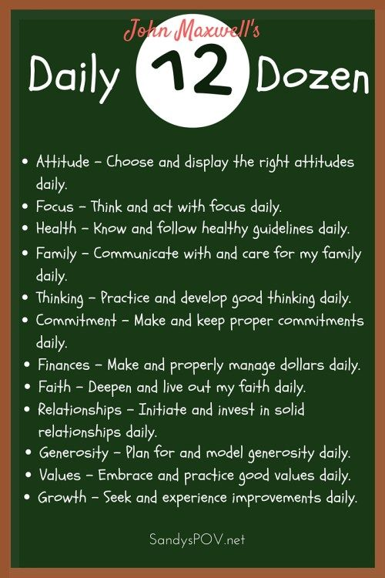
Make Today a Masterpiece
Determine what twelve decisions are important to you.
Begin with the “Daily Dozen” list and modify it according to your life.
Start making the decisions and evaluate your life choices daily.
Move your life towards the direction you desire.
Worry about today and tomorrow will happen itself.

