Slide 1
Food as Medicine Everyday
Reclaim Your Health With Whole Foods

Slide 2
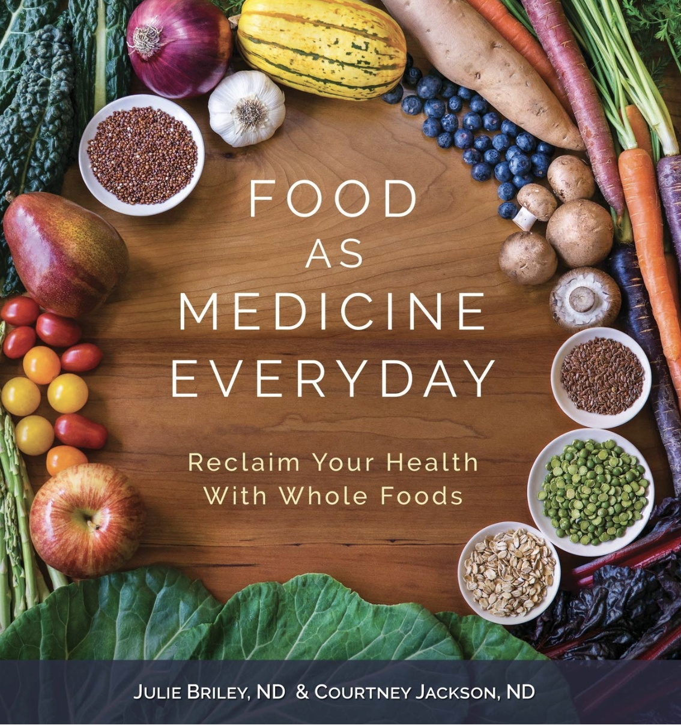
Food As Medicine Everyday
Julie Briley, ND (left) & Courtney Jackson, ND (right)
Dr. Briley and Dr. Jackson are naturopathic physicians and co-founders of the Food As Medicine Institute at National College Of Natural Medicine in Portland, Oregon
Both women also work at private practices in their home of Portland, Oregon
Notes:
Naturopathic doctors are trained to diagnose and treat acute and chronic health conditions from infancy through adulthood.
They may also provide holistic medical treatment for patients who are using more conventional methods
Naturopathic medicine is distinguished from other medical professions by its principle - the healing power of nature. This is the potential for a whole foods diet to prevent, treat, and reverse many chronic diseases.
When prescribing treatment, ND’s do not first rely on prescription medication or surgery
Instead, they prescribe treatment options that address the whole person such as clinical nutrition, lifestyle counseling, botanical medicine, and so on

Slide 3
Topics:
The Standard American Diet
Nourishing Yourself with Fats, Carbohydrates, and Protein
Reading Food Labels
Whole Foods, Plant-Based Diets
Strategies for Digestion
Healthy Habits
Eating on the Go & Grocery Shopping

Slide 4
Objectives:
Learn how to move away from the Standard American Diet
Understand the power of food as medicine and, therefore, how food is part of the solution
How to start making changes today

Slide 5
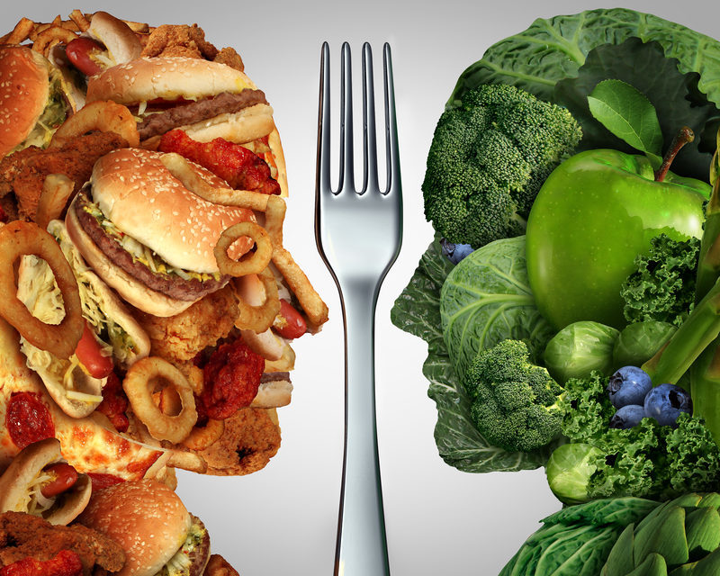
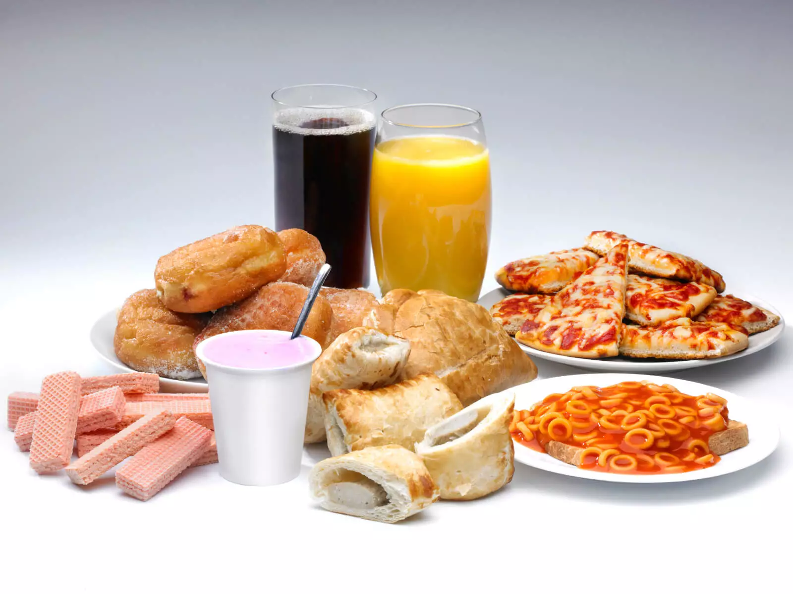
The Standard American Diet
And Why it Just Won’t Do

Slide 6
What is the SAD?
Standard American Diet
Calorie-rich, nutrient-poor, highly processed, and low in whole foods
Lacking in vegetables, especially dark leafy greens
May lead to chronic disease and chronic inflammation
High in added sugars and preservatives
The result of the industrialization of foods in the late 1800s
Notes:
Exactly what comes to mind when you think “American food”
The result of a problem of access and education
Contributes to our country’s epidemic of poor health
History of food production in america
In the late 1800s, more people were moving into the cities from the country, distancing them from a closer connection to their food
Because of industrialization of food production
As a consequence, there was a shift away from a whole foods, low processed diet
The transition contributed to increasing rates of chronic disease from a highly processed diet with decreased nutritional value

Slide 7
Why the SAD Cannot Continue
The CDC reports that non-communicable (NCDs) diseases are now the major cause of death and disability worldwide
Cancer, heart disease, diabetes
As of 2020, NCDs account for seven out of every ten deaths in the world
Principle causes of premature death from NCDs are tobacco use, alcohol consumption, physical activity, and poor diet
According to the International Food Information Council 52% of Americans said it was easier to do their income-tax returns than it is to figure out how to eat healthfully!

Slide 8
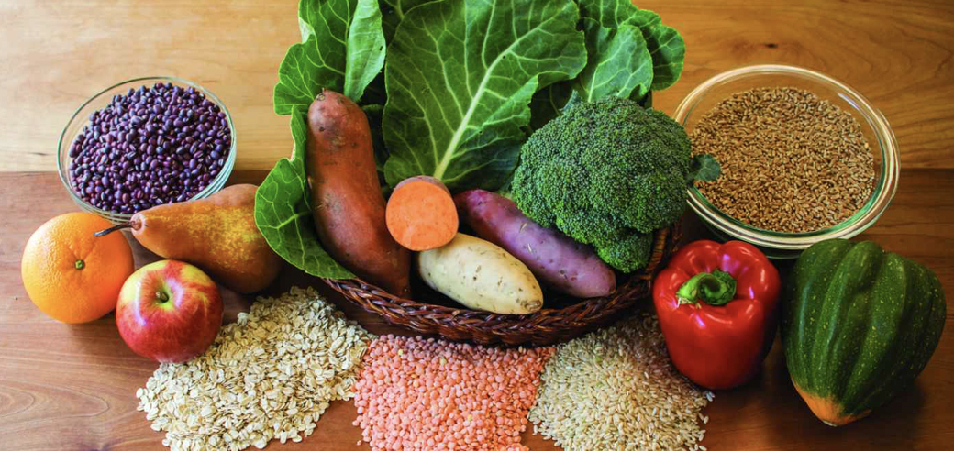
Nourishing Yourself With Fats, Carbohydrates, and Proteins

Slide 9
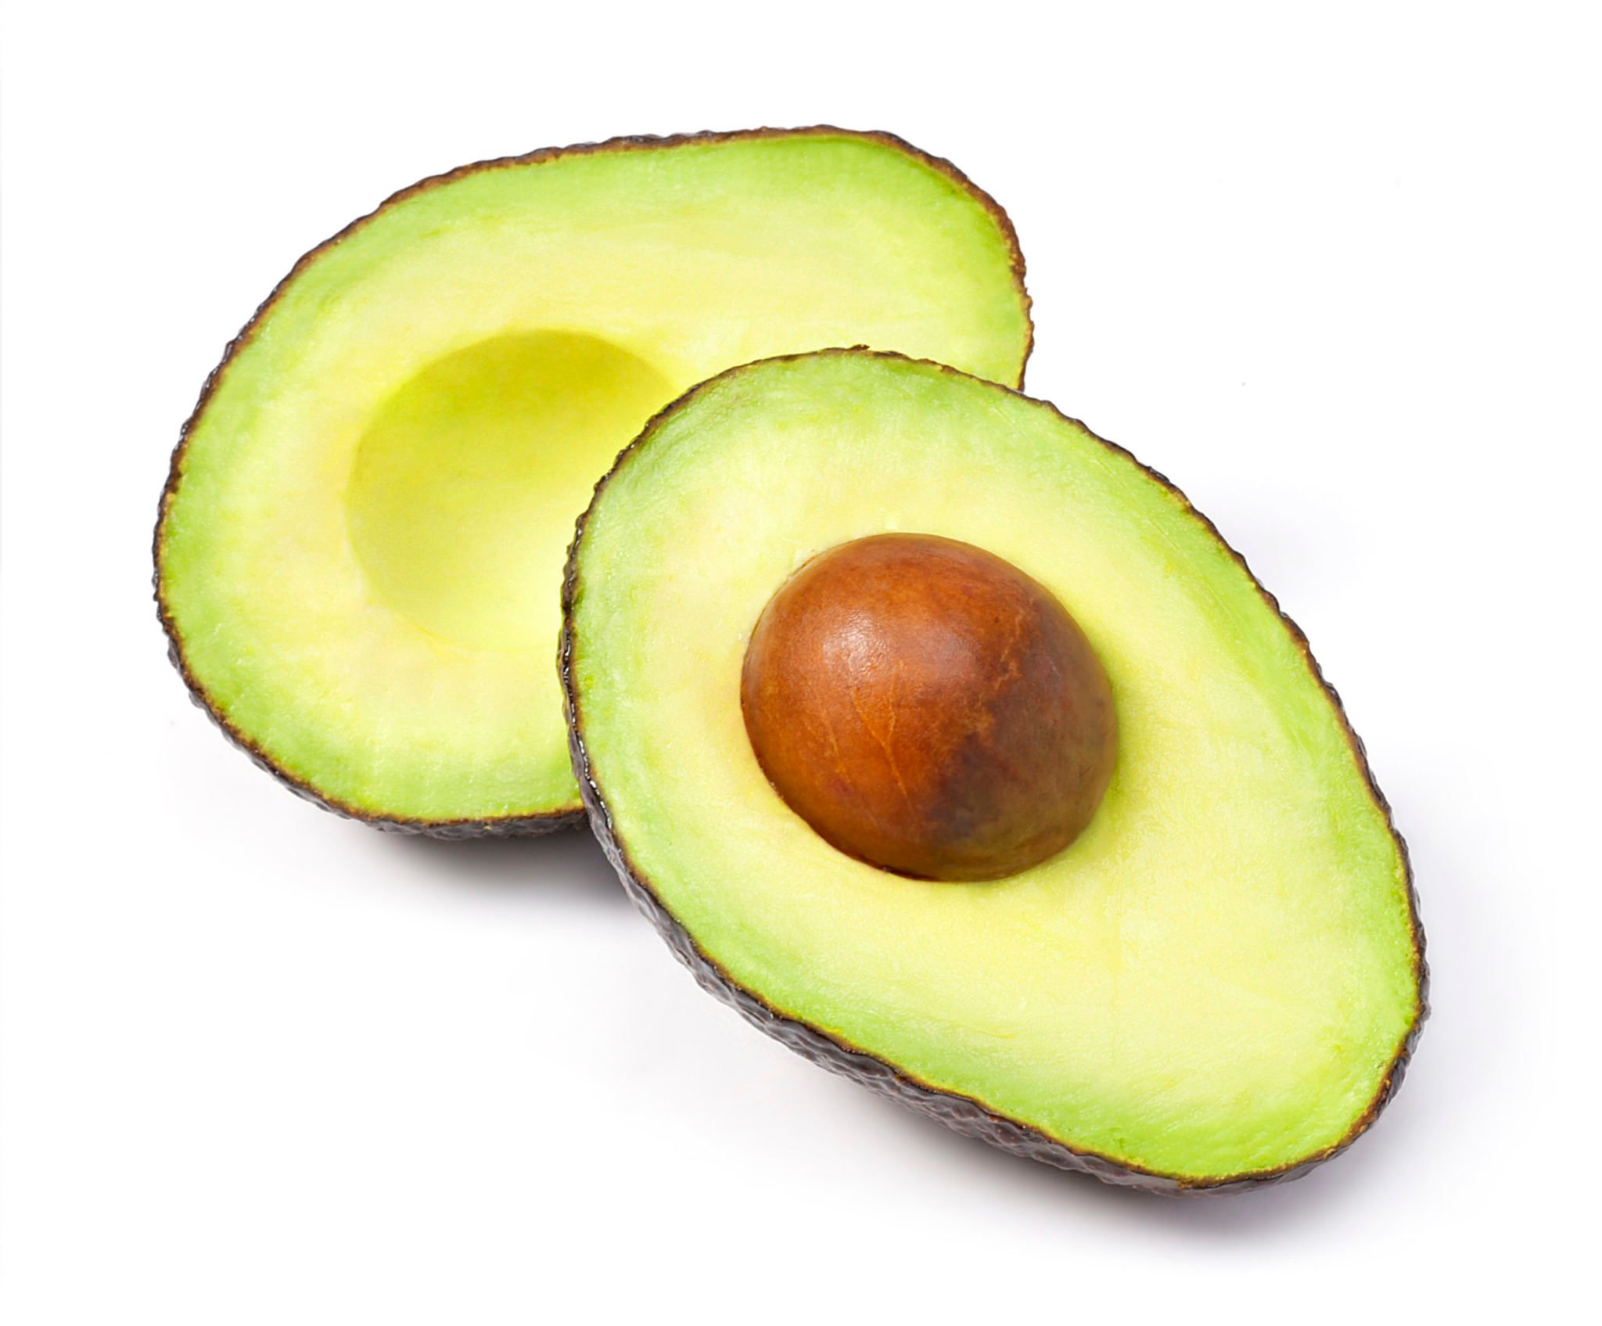
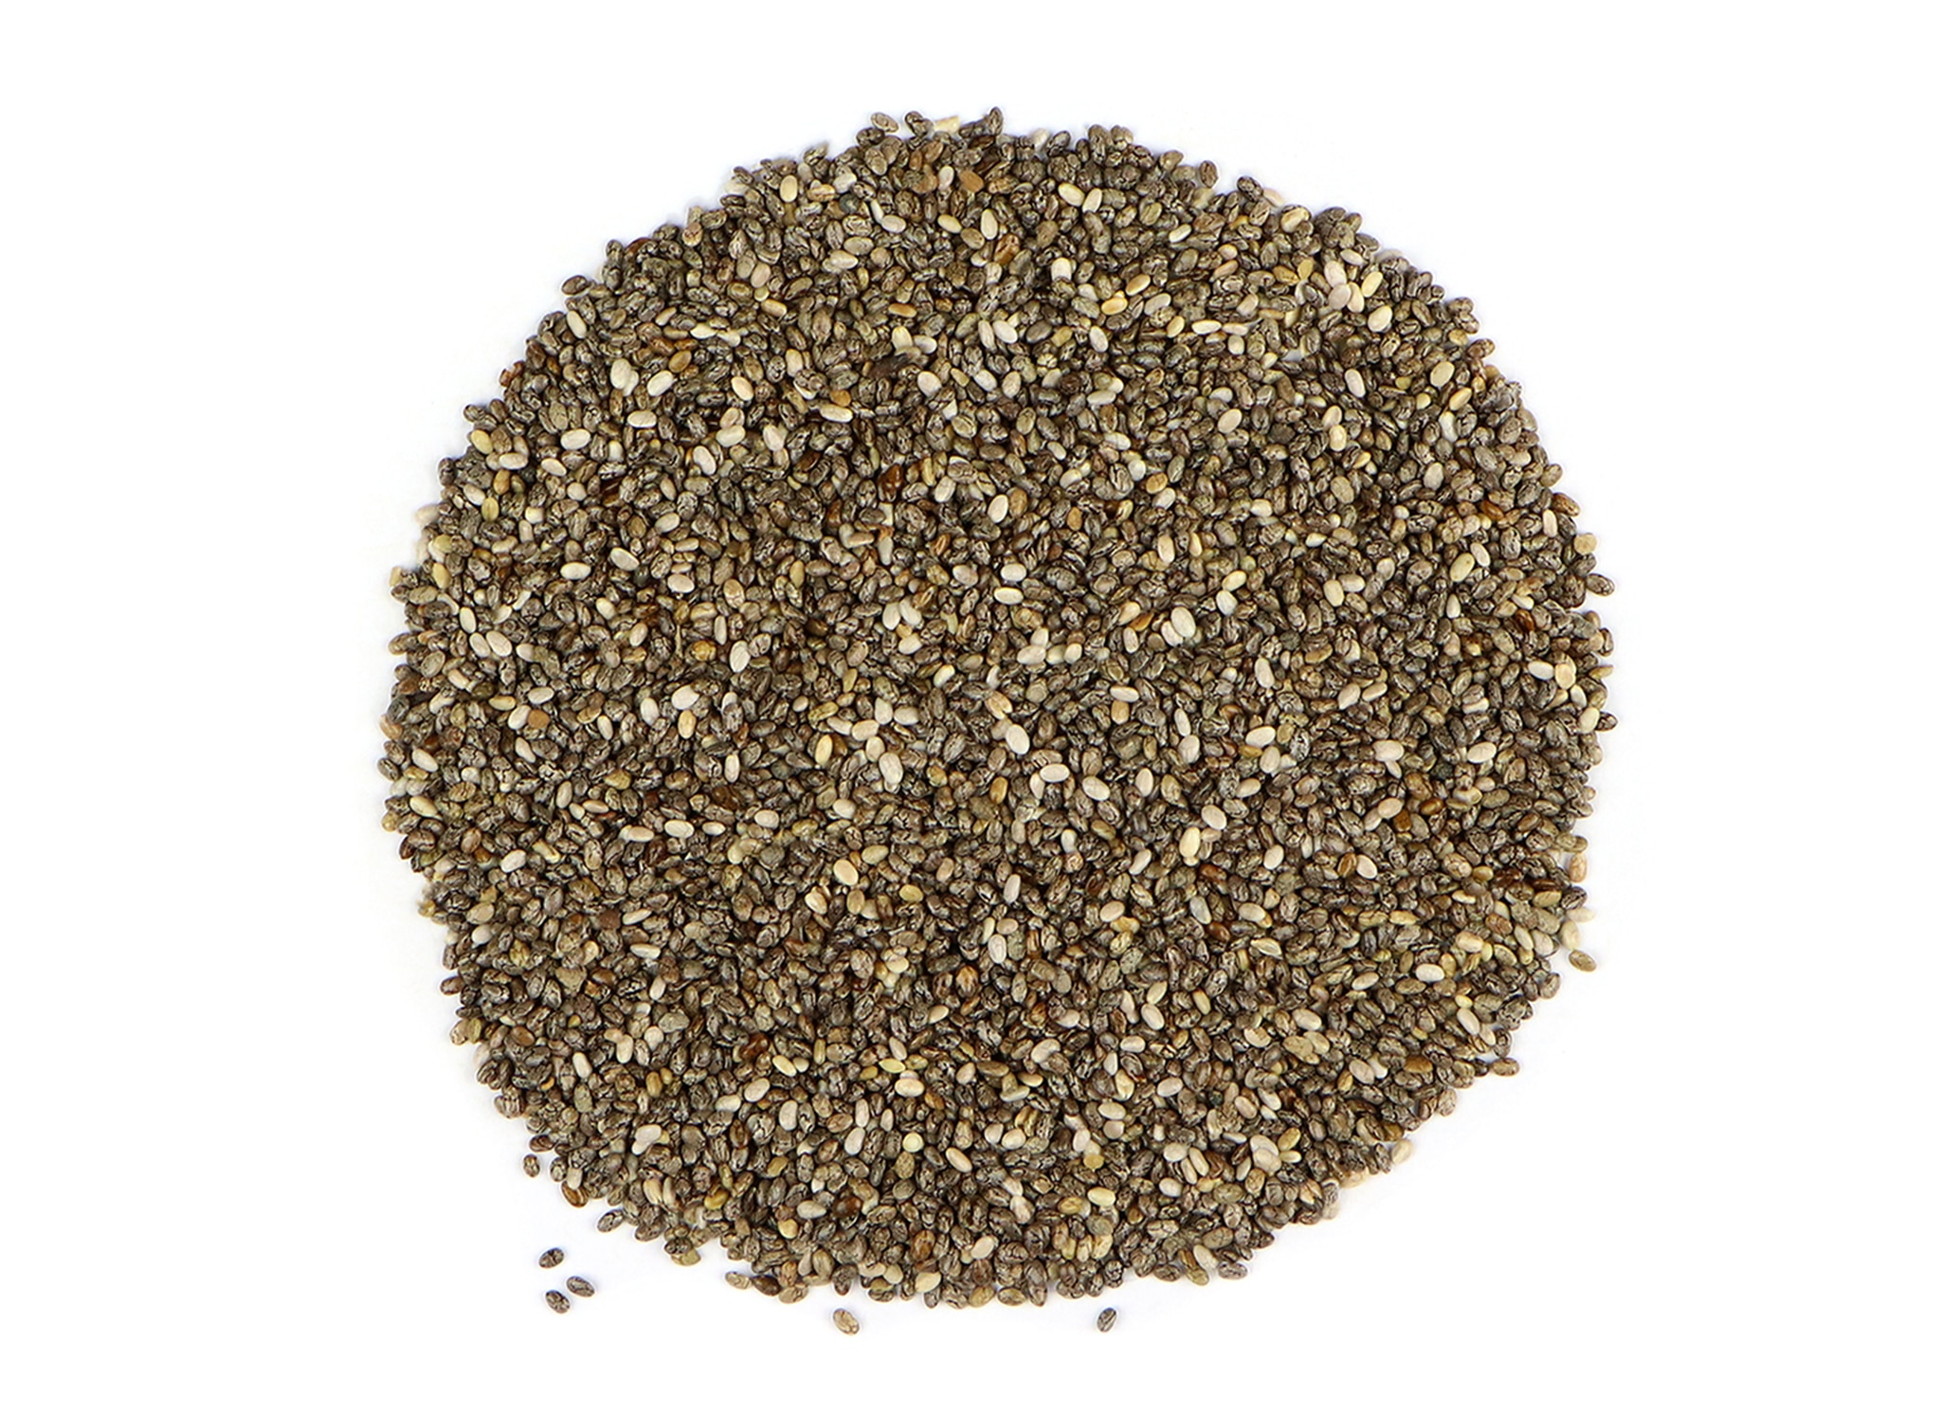
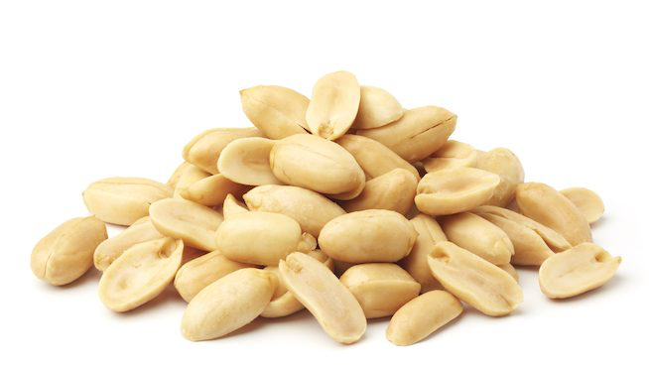
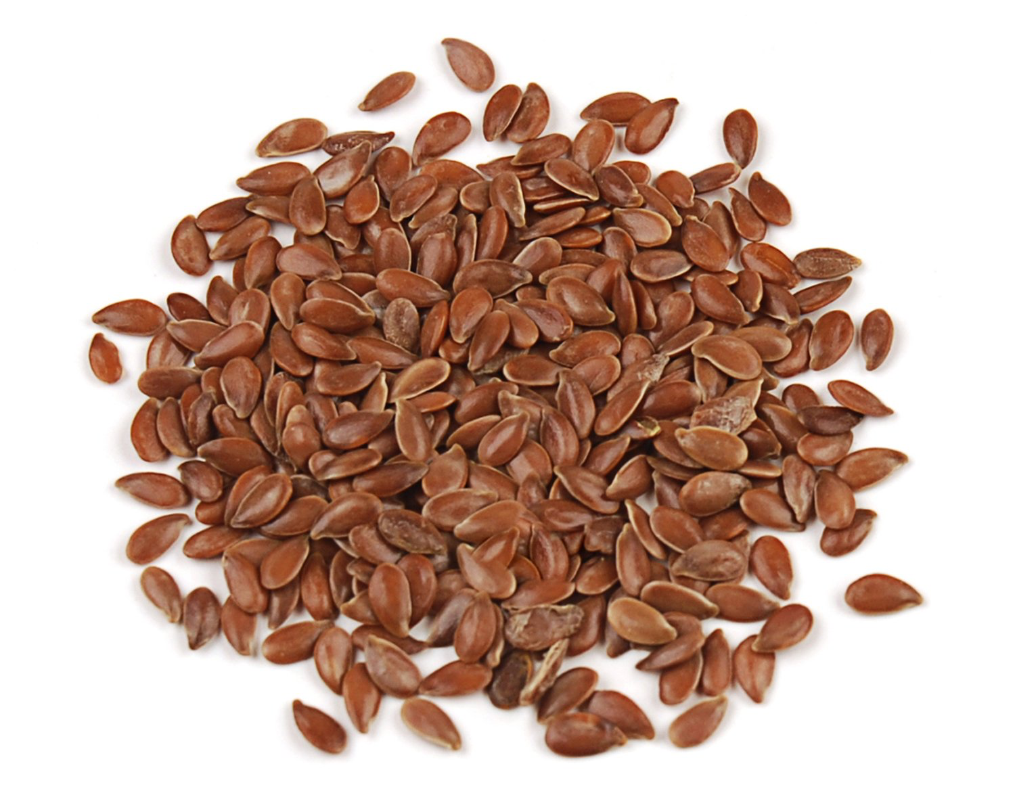
Fats
Fats are an essential nutrient to include in a daily diet
The best fats are less processed and remain closer to their natural form
The body digests fat more slowly than proteins or carbs, so it can give you long term energy and helps you feel satisfied from a meal
Natural sources of fats come from plants
Two types: unsaturated and saturated
Notes:
The subject of fats in our diet is controversial
Americans have heard a lot of conflicting messages about low-fat diets, unsaturated fats diets, and low saturated fats diets
Healthy fat is good for us
The difference between saturated and unsaturated fats
Unsaturated fats are liquid at room temp - olive oil, avocado oil
Saturated fats are solid at room temperature - butter, coconut oil

Slide 10
Unsaturated Fats
Helps body create and balance a healthy level of inflammation
Saturated Fats
Monounsaturated Fats
Polyunsaturated Fats
Avoid/limit saturated fats.
High consumption can lead to inflammation, high cholesterol, and CVD
Olives
Avocados
Peanuts
Sesame Seeds
Referred to as “essential” because the body cannot make them naturally
Contain omega-3 and omega-6 fatty acids
Americans typically consume too much omega-6 fatty acids - which promote inflammation
High In Omega-3 Fatty Acids:
Flaxseed
Chia Seeds
Walnuts
High In Omega-6 Fatty Acids (need to avoid/limit):
Corn Oil
Soybean Oil
Safflower Oil
Animal Sources:
Dairy products (milk, cheese, butter)
Bacon and sausage
Poultry skin (chicken, turkey)
Egg yolks
Plant Sources:
Coconut oil
Chocolate
Palm Oil
Notes:
Omega-3 fatty acids reduce inflammation while omega-6 fatty acids promote inflammation
Healthy ratio of omega-6 to omega-3 is 4:1
Americans typically consume a ratio of 16:1 to 20:1

Slide 11
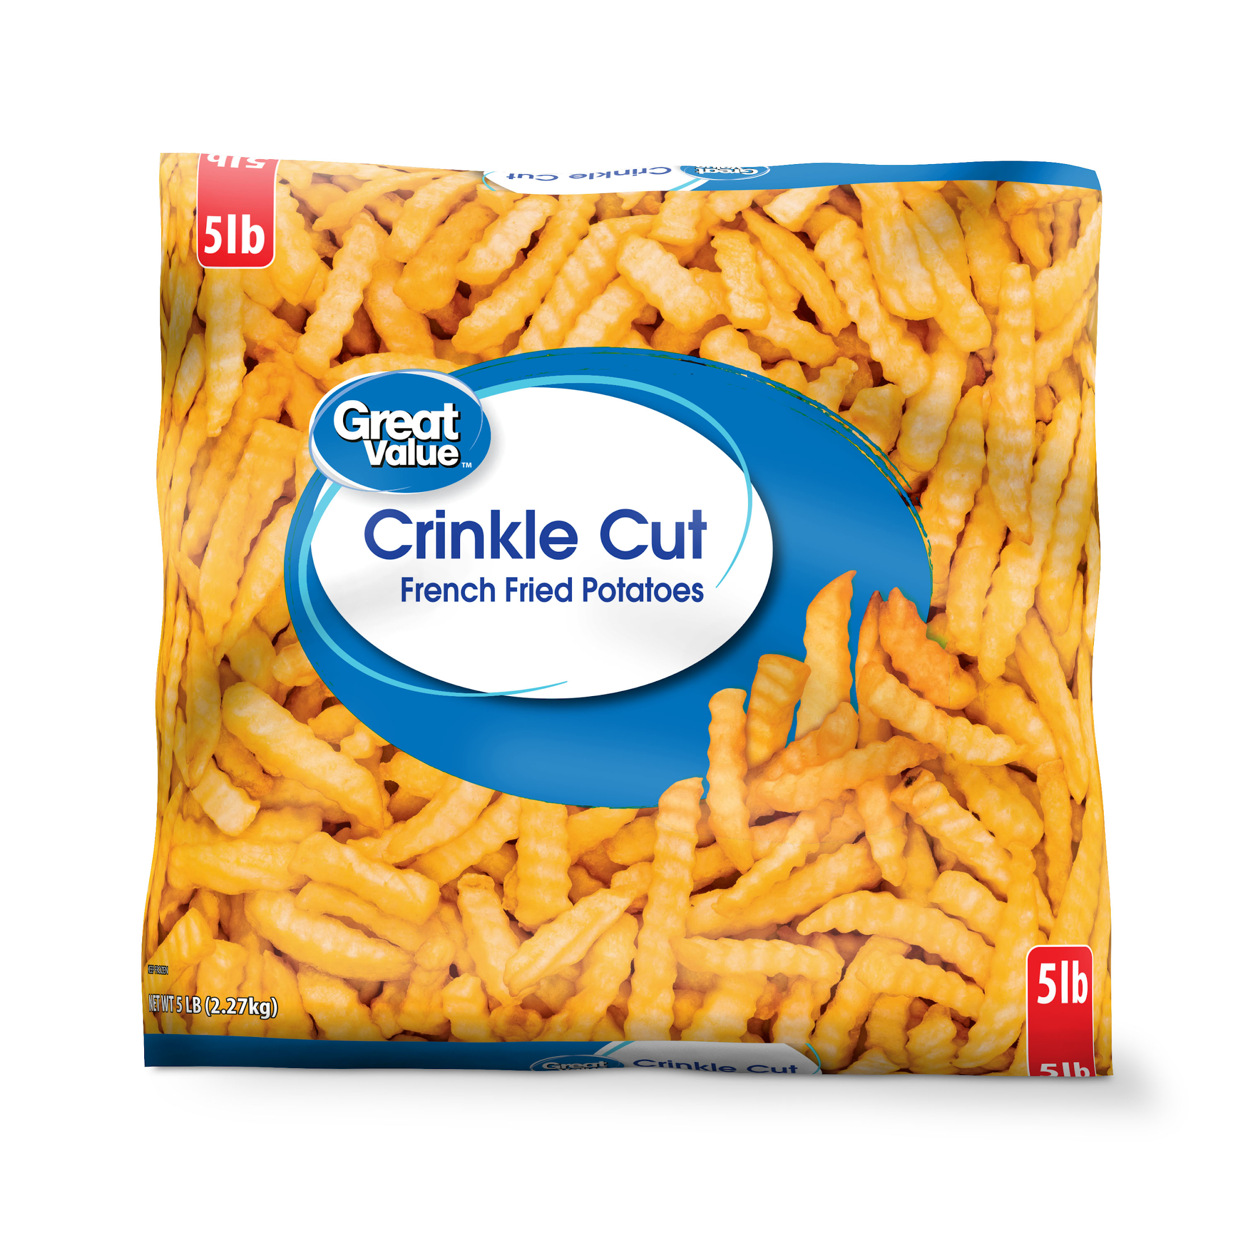
What to AVOID: Trans Fats
Otherwise known as partially hydrogenated oils
Created to give food a longer shelf life and used in the fast food industry to fry and stabilize packaged food products
Increases inflammation in the body and is strongly linked to heart disease and unhealthy changes in the brain
Should be completely avoided!
Sources: margarine, french fries and most fried foods,
packaged baked goods
Notes:
Increases inflammation in the body and is linked to heart disease and Alzheimer’s disease
American Heart Association, American Diabetes Association agree that trans fat should be completely avoided

Slide 12
The Bottom Line
Eating excess fat makes it much harder to reach and maintain a healthy body composition.
Eating healthy, low processed fat is good for your diet
Fat provides slow fuel for your day and helps you feel satiated

Slide 13
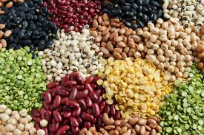
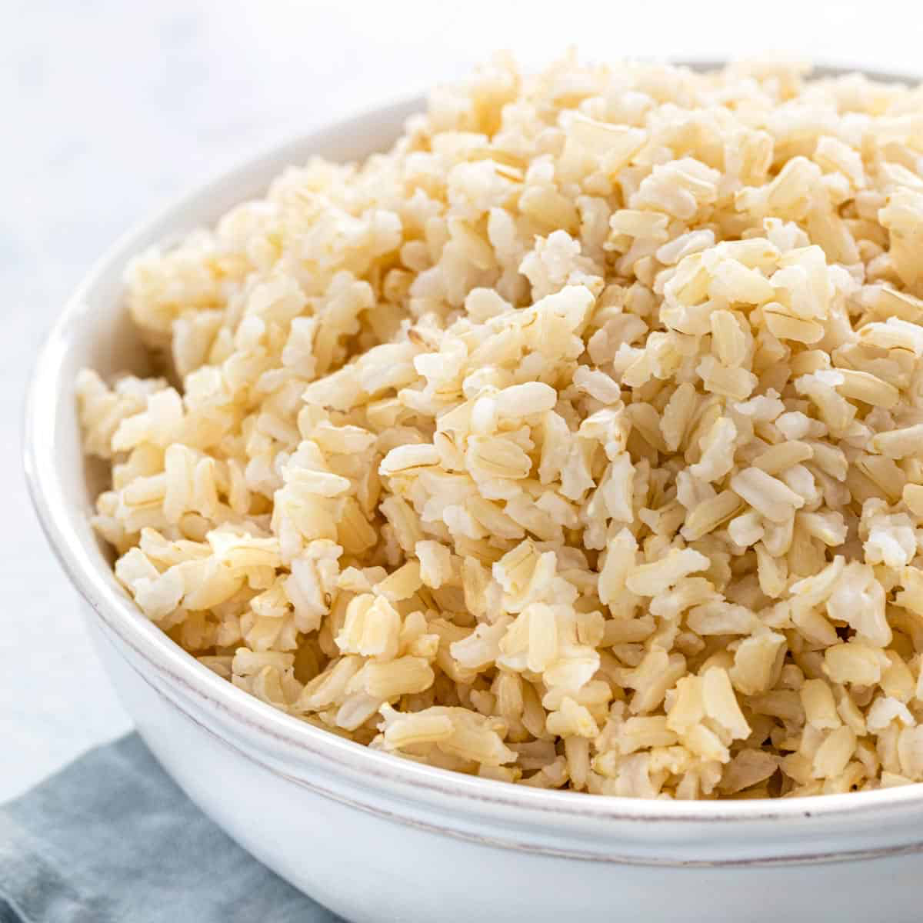
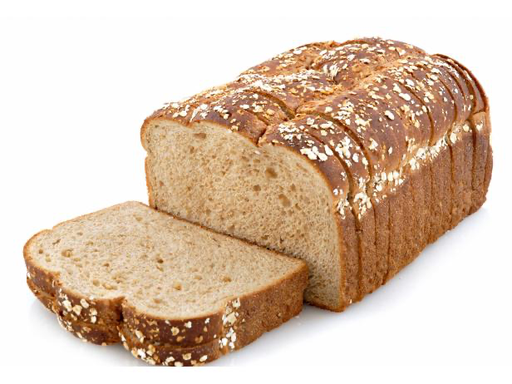
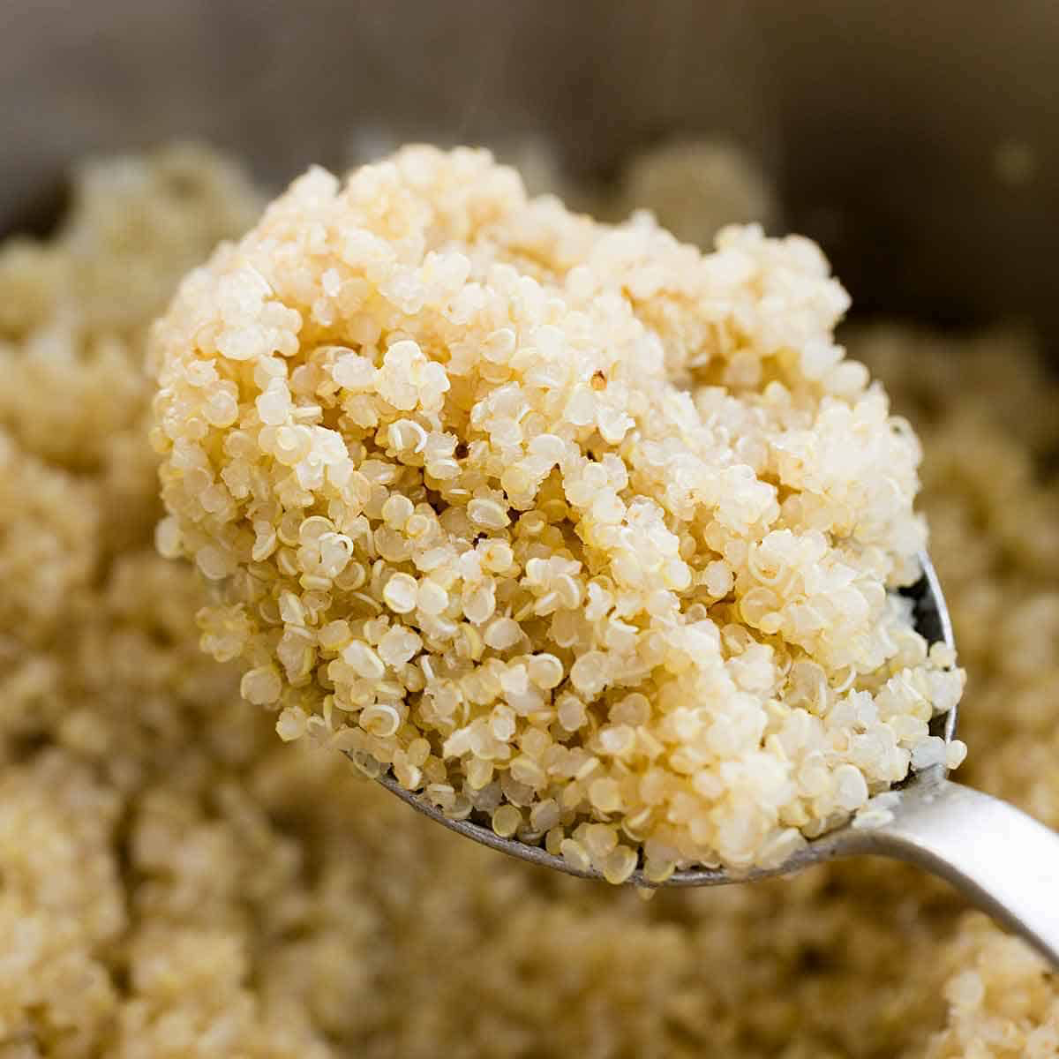
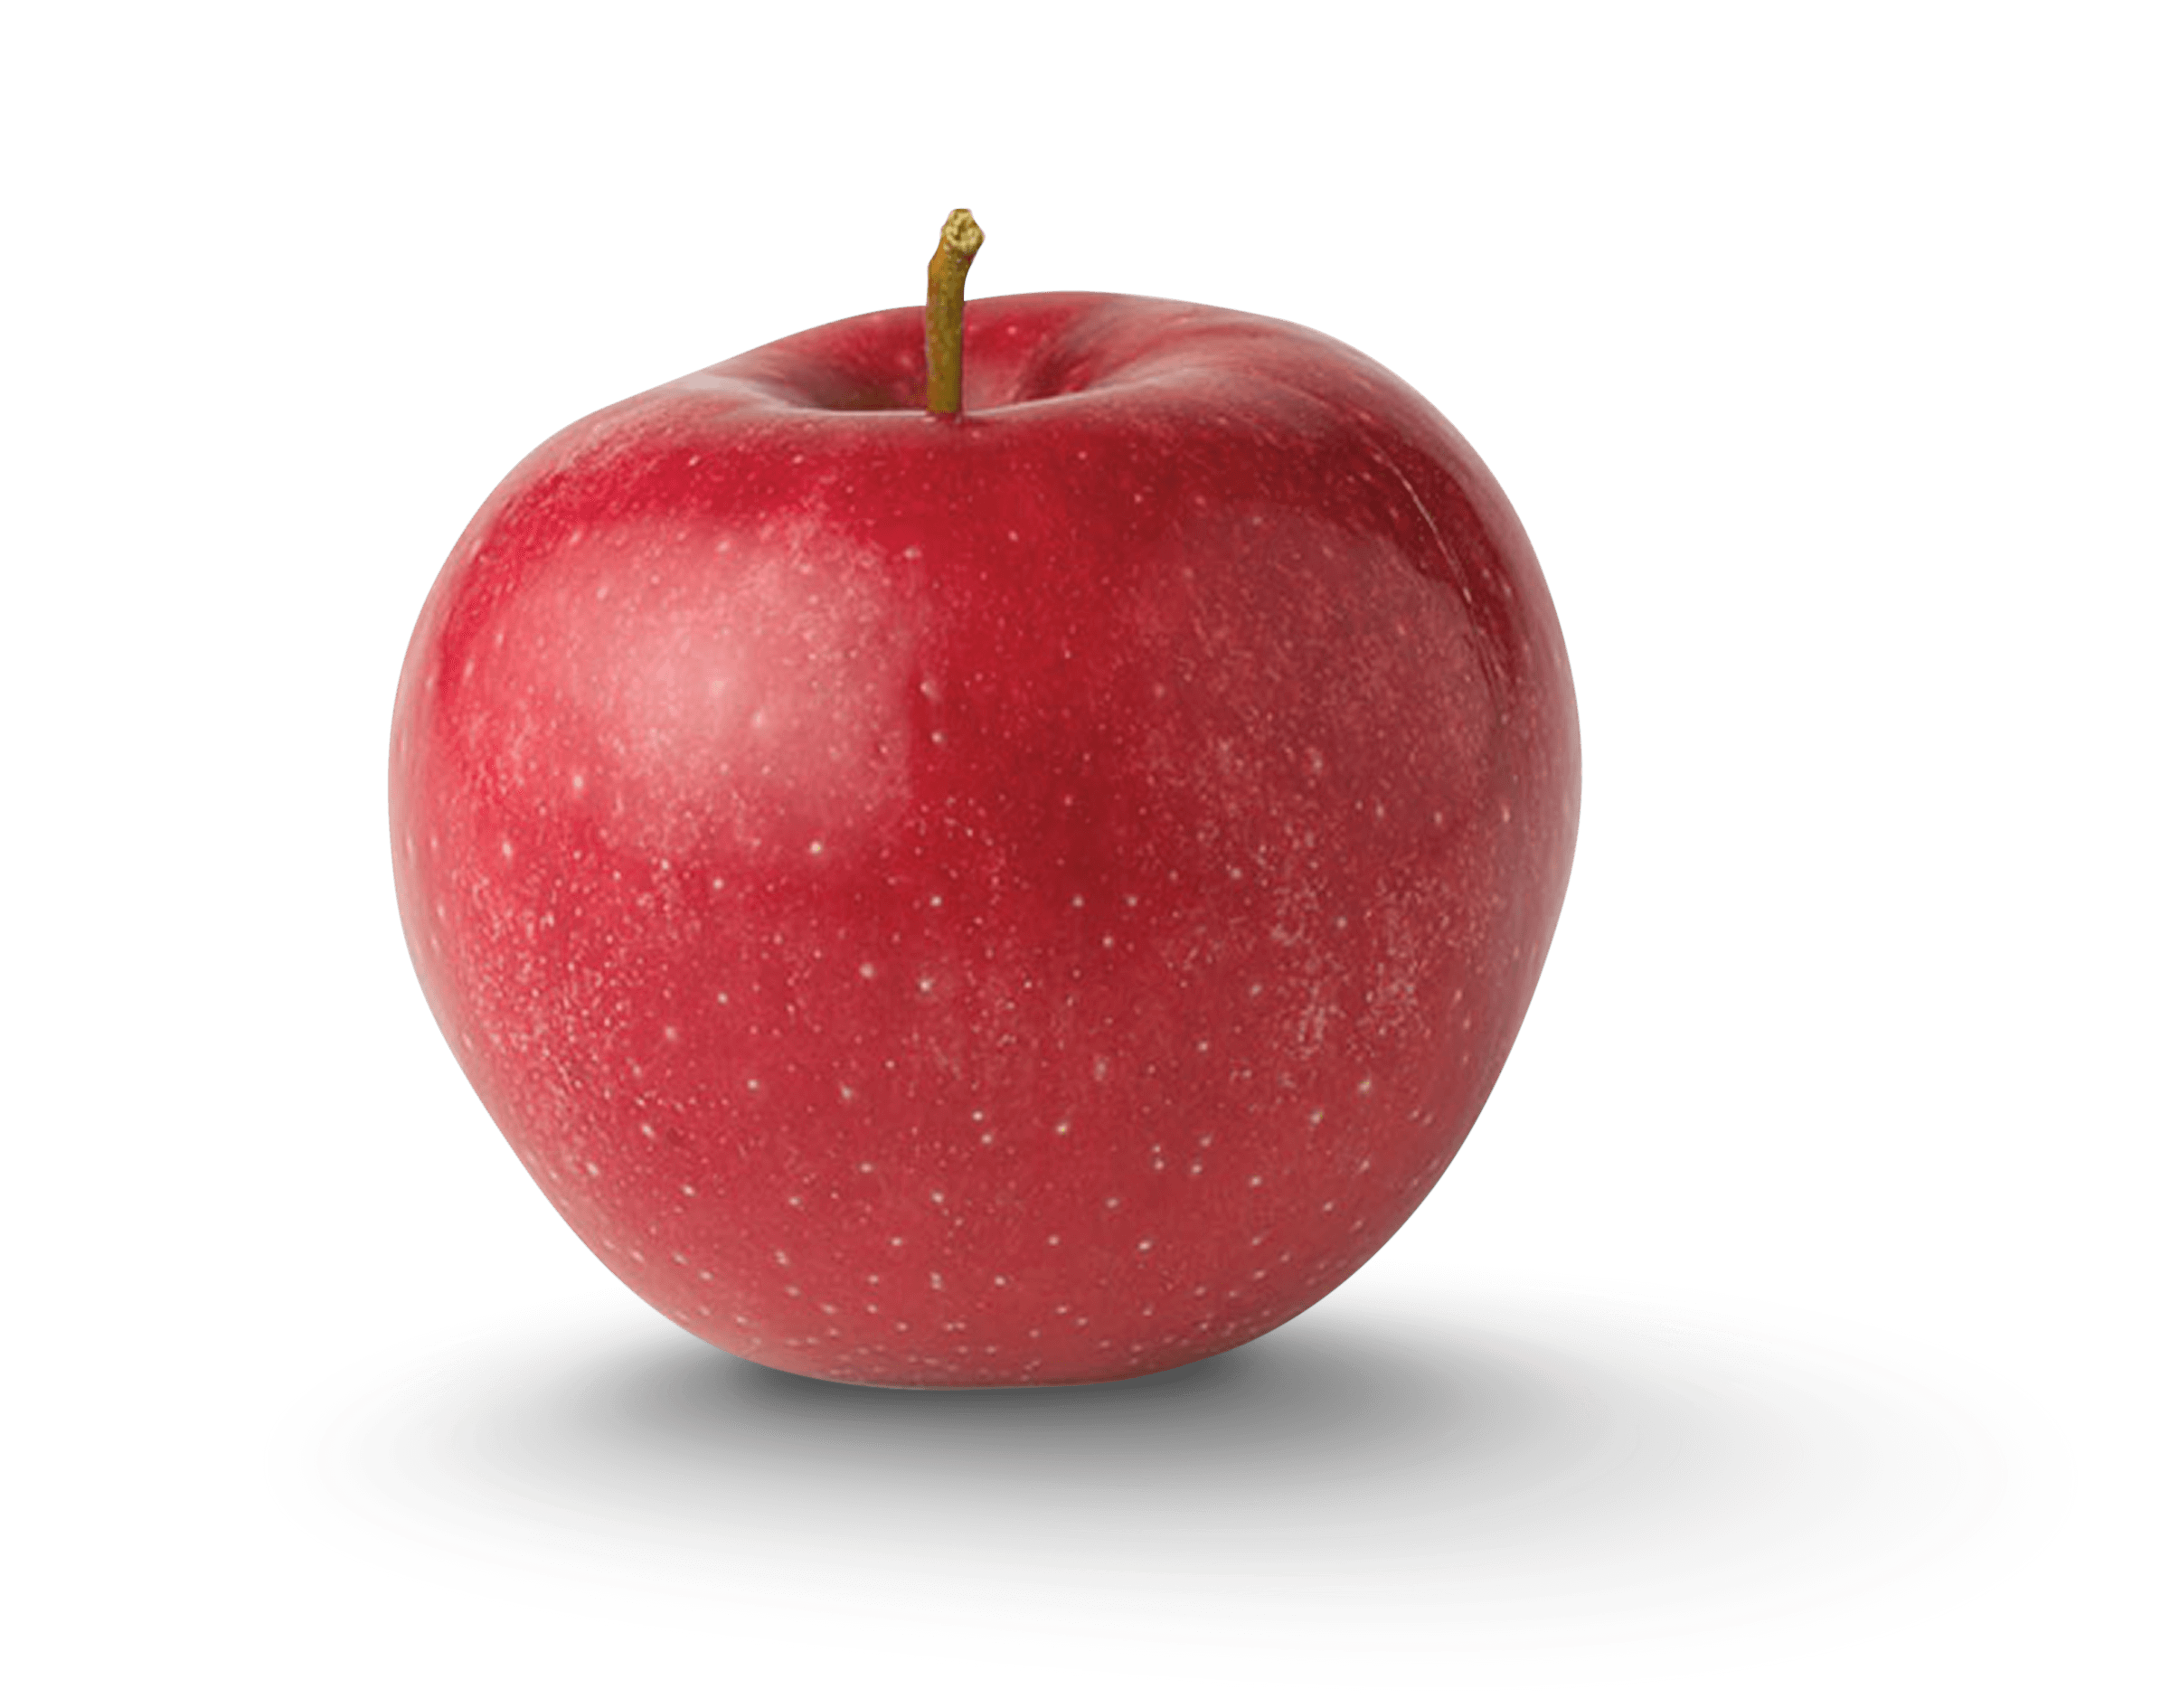
Carbohydrates
The Benefits of Carbs:
Energy for the brain from glucose
Fuel Storage in the form of glycogen
Sources of phytonutrients - which include antioxidants
Satiety and balanced cholesterol
Important: starches, fiber, and sugar ALL refer to carbohydrates
Two forms - complex carbohydrates and simple carbohydrates
Notes:
It is important to navigate carbs well - choosing poorly can lead to weight gain, insulin resistance, heart disease, inflammation, and decreased immune function
phytonutrients - chemicals produced by plants that have anti-inflammatory benefits

Slide 14
Complex Carbohydrates
Simple Carbohydrates
Examples:
Legumes and beans
Nuts and seeds
Vegetables
Whole fruits
Whole grains
Examples:
Sugar
Fruit Juice
Sweetened beverages (soda, energy drinks)
Honey, maple syrup
White pasta, white bread
Effects on the Body:
Provide slow energy for your body and brain
Fiber helps the body remove waste and excess cholesterol
Provide important fuel to sustain friendly bacteria in the gut
Effects on the Body:
Provide quick energy for your body and brain
Taste sweet
Excess can lead to cavities, weight gain, diabetes
Notes:
Complex carbohydrates are longer chains of simple carbs and are also called polysaccharides
Simple carbohydrates can be referred to as monosaccharides or disaccharides

Slide 15
Let Fiber Be Your Guide
Fiber is a crucial component towards a more plant-based diet. It is an indigestible complex carb that has numerous benefits.
Soluble Fiber attracts water, which creates bulk in your gut and slows down digestion - making you feel full
Apples, pears, oatmeal, beans, lentils, nuts, flaxseed
Insoluble Fiber contributes to regular bowel movements, preventing constipation
Whole grains, dark leafy green vegetables
Fiber also helps control blood sugar levels, balance blood glucose, reduce the risk of heart disease, and reduce the amount of calories eaten per day
Notes:
Excellent sources of fiber include whole fruits, vegetables, beans, peas, legumes, nuts, seeds, and whole grains
Plant foods provide fiber - animal products do not
Fiber is categories as soluble or insoluble
Helps maintain healthy cholesterol by assisting the removal of cholesterol from the body

Slide 16
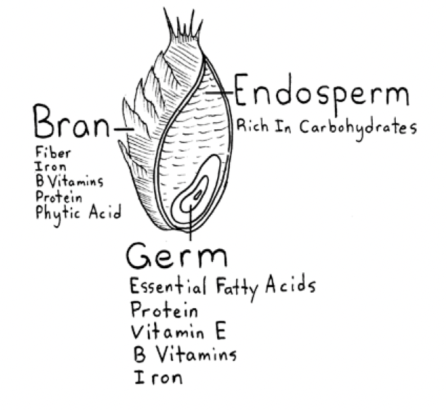
Whole Grains
How much do we need?
35 to 50 grams per day
How Do I Increase Fiber in my Diet?
1. Eat a whole piece of fruit and skip the juice
2. Choose whole grains (brown rice) over refined grains (white rice)
3. Add vegetables to every plate!
4. Include fiber rich foods into every meal.
5. Mix beans into your diet as an alternative for animal protein
Notes:
Barley, brown rice, oats, whole corn, quinoa
Bran = protective outer layer of the grain
Excellent source of dietary fiber
Provides B-vitamins and trace minerals like iron
Germ = provides essential fatty acids (omega-3 and omega-6) and vitamin E
Food manufacturers remove this part of the grain to ensure a longer shelf life, which robs us of all the germ’s valuable nutrients
Endosperm = includes starch, protein, and some B-vitamins
Refined grains - removing the germ and the bran, leaving just the starchy endosperm
Removing so many nutrients

Slide 17
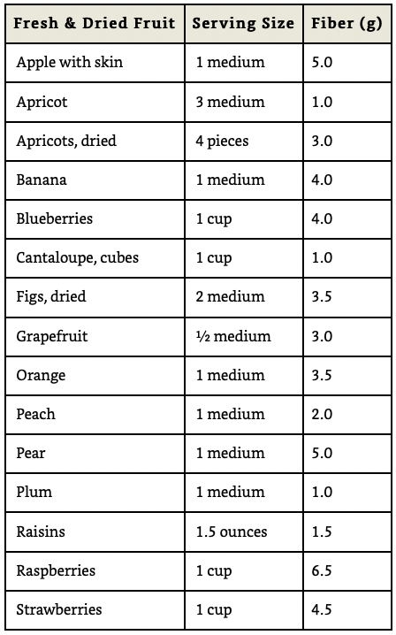
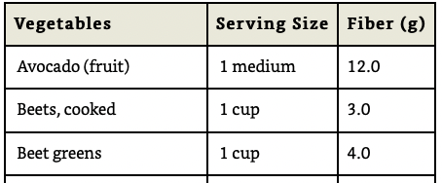
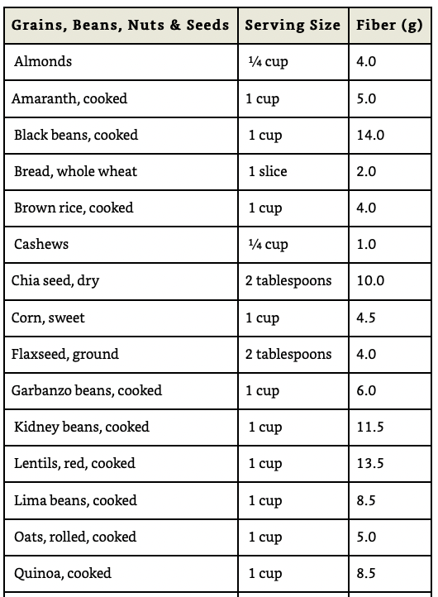
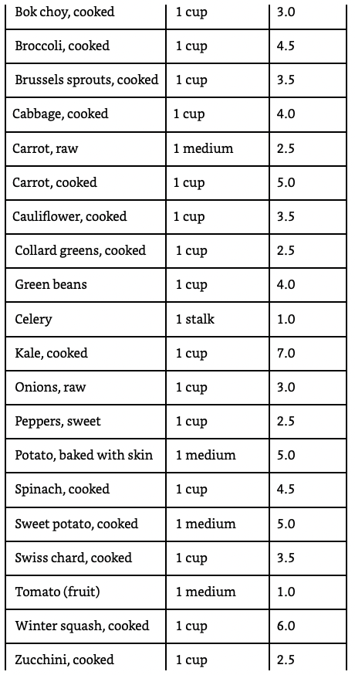
Notes:
Food sources of fiber - not going to go through them all, just trying to show how many plant sources of fiber there are

Slide 18
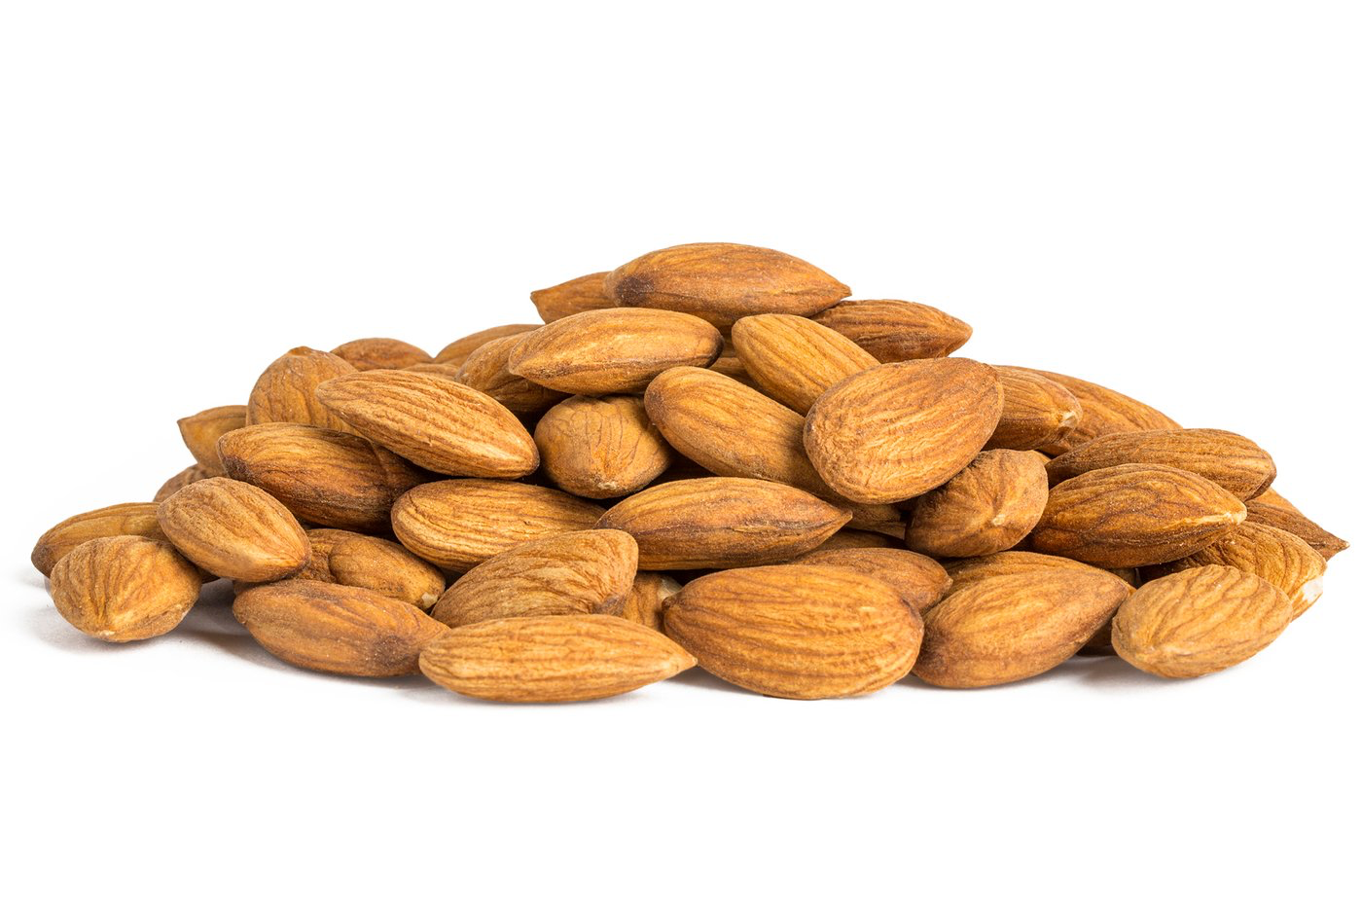
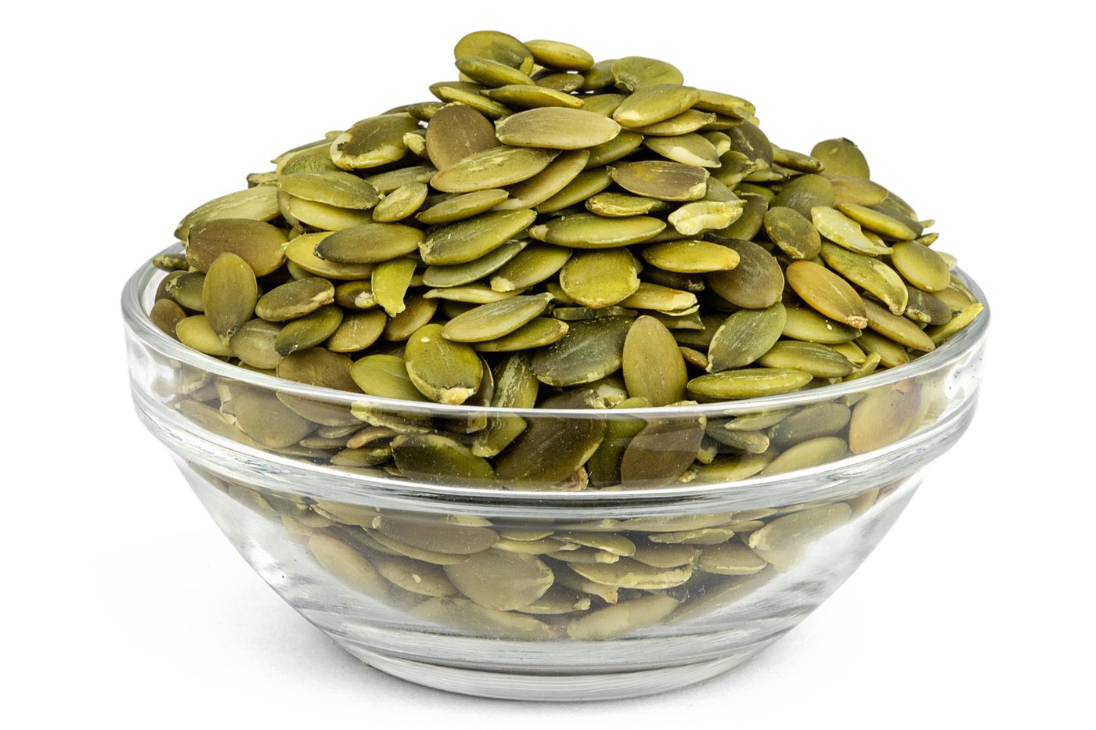
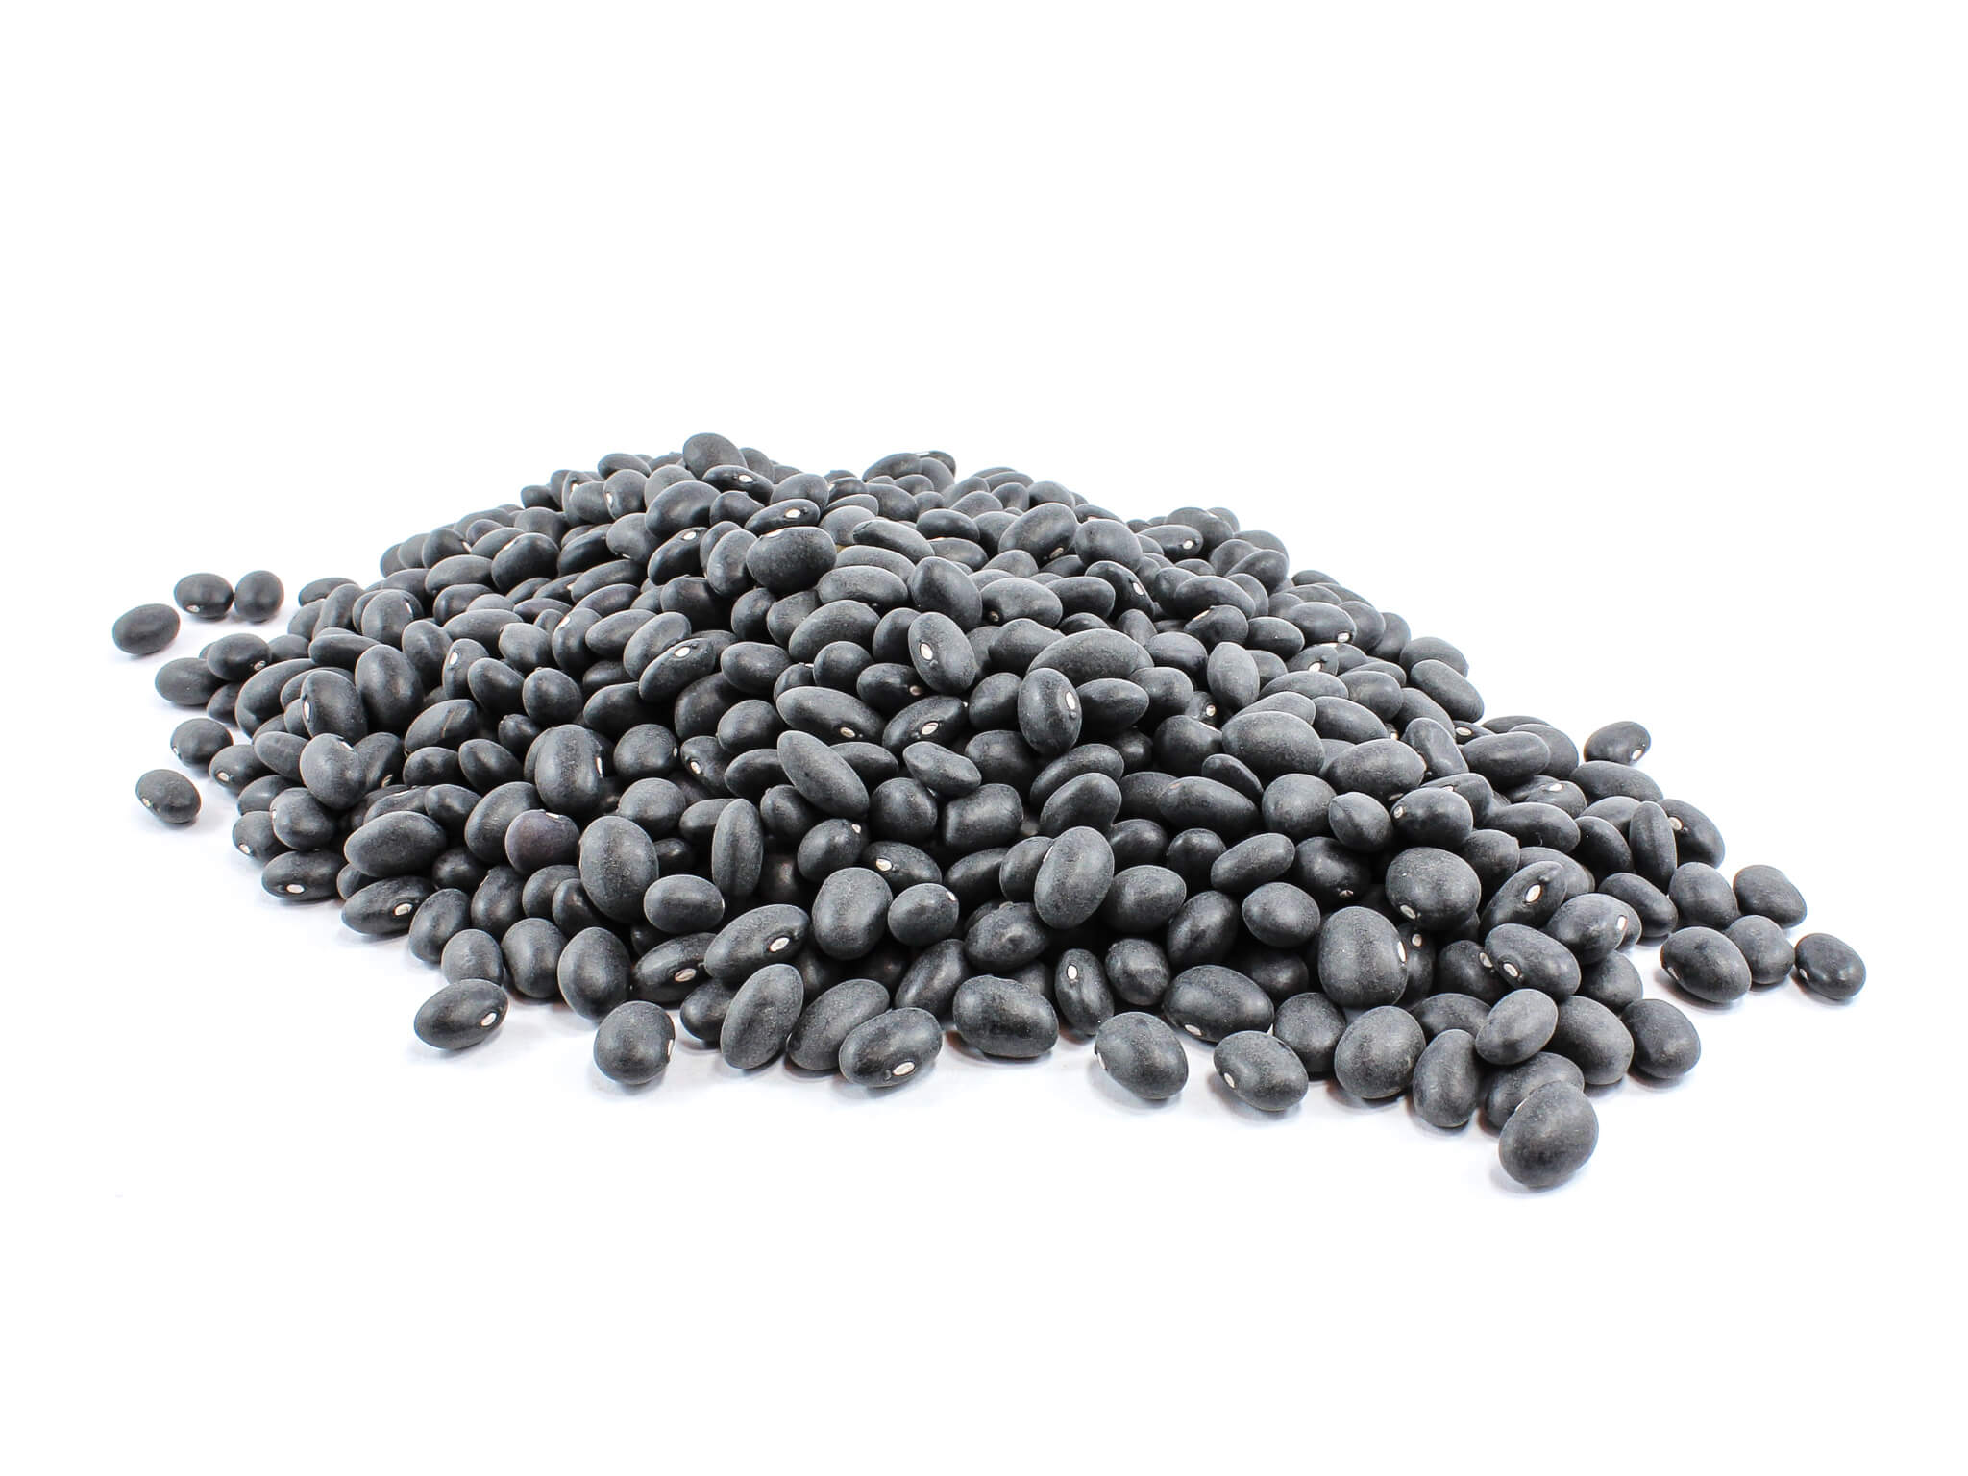
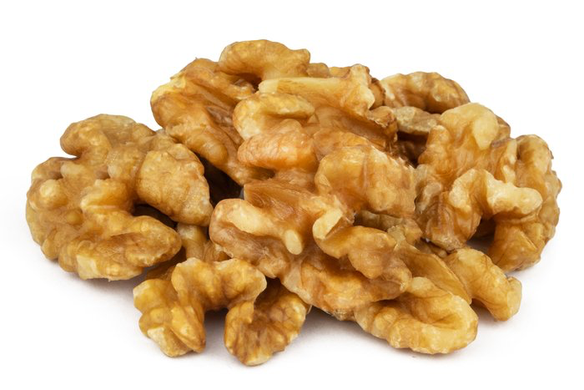
Protein
Provides structure in the body in the form of connective tissue, bone, hair, and muscle
Controls every chemical reaction in the body through the formation of enzymes
Serves as a slow fuel source
Plant Protein
Almonds, walnuts, chia seeds, beans, legumes, whole grains
Animal Protein (Avoid/Limit)
Beef, pork, poultry, fish, eggs, milk, cheese, yogurt
Notes:
Another essential macronutrient made of building blocks called amino acids
Slow fuel source similar to fats and complex carbohydrates
Diets with low quality protein can lead to fatigue, mood swings, difficulty building muscle, and hormone imbalances

Slide 19
Protein
How much do we need?
0.8 grams per kilogram of body weight for adults
So, a 150 lbs individual (68kg) would need approximately 55 grams per day
Amount can change based on age, health status, activity levels, pregnancy, and fitness goals
If you are eating enough unprocessed food to reach and maintain a healthy weight then you will get adequate protein.
Tip: Look for foods that are rich in protein instead of foods that would require consuming a large portion to meet the daily protein intake
Notes:
The amount of protein a person needs can change based on age, health status, pregnancy, fitness goals
Etc - Older adults, people trying to build muscle need more protein
Another way to calculate protein - Dietary Reference Intake recommends that 10%-35% of your total calories should come from protein in healthy adults
So if you are eating 2,000 calories a day, you should consume anywhere from 50 grams (10%) to 175 grams (35%) of protein

Slide 20
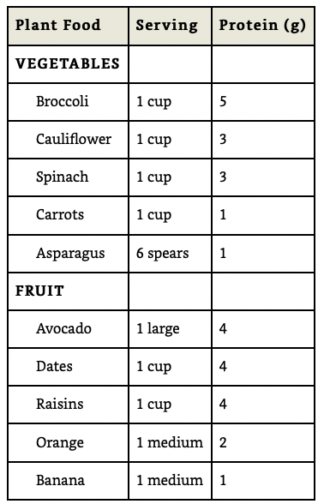
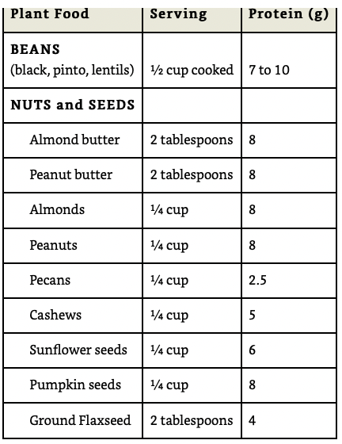
Plant Sources of Protein
Notes:
Notice how many plant sources of protein there are
Many people think in order to get enough protein they need to eat chicken, steak, and beef
While animal foods do have more protein per serving generally, don’t forget about plant food (beans, broccoli, etc)

Slide 21
Don’t Forget Micronutrients!
By eating a whole foods plant-based diet you will naturally introduce rich sources of vitamins and minerals to your body. Highly processed foods often have these important nutrients removed or altered.
Sources of Vitamins and Minerals:
Vitamin A: oranges, carrots, squash, spinach, kale
The B Vitamins: dark leafy greens
Vitamin C: broccoli, cauliflower, citrus fruit, peppers, berries, melons
Vitamin E: whole grains, nuts, seeds, dark leafy greens
Vitamin K: dark leafy greens
Potassium: avocados, kiwi, bananas, cantaloupe, melons, spinach
Calcium: kale, spinach, broccoli, almonds
Notes:
point out calcium - don’t need to drink milk/dairy to get it
emphasis on how many vitamins/minerals dark leafy greens provide

Slide 22
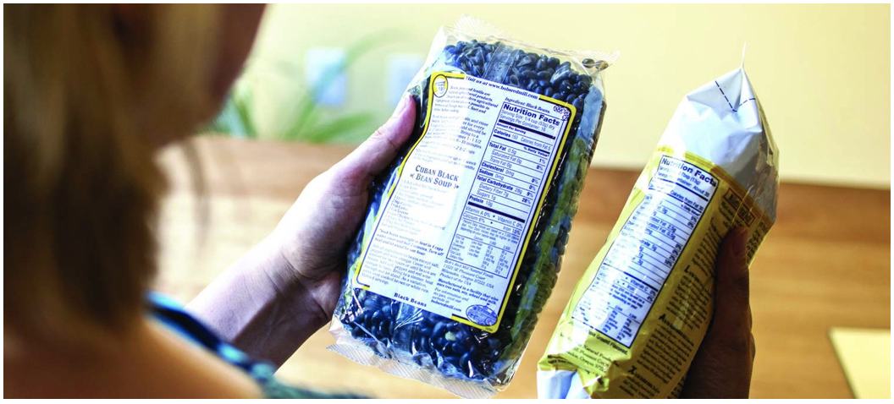
Reading Food Labels

Slide 23
Food Labels
Food claims on the front of food packaging may have little to do with the actual nutrition in a food.
Food companies may use certain manipulative and confusing language to sway your shopping habits.
Here are some steps for reading food labels
Notes:
In order to make the healthiest choices possible when shopping, skills in confidence in reading food labels cannot be understated
When people look at packaging for a food item, they see
Maybe the number of calories
The percentage of fat
A label that says “heart healthy”
Reading food labels is an acquired skill that takes practice but it is well worth it
One of the easiest ways to start choosing healthier options

Slide 24
Step 1: The Ingredients
Assess the following in order:
1. Length of the list - when a product has a lot of ingredients, it is likely to contain additives such as preservatives, food coloring, and added flavors
4. Fats - Read list for anything that says partially hydrogenated, that means there is trans fat (even if the total trans fat is listed as 0 g). There can be up to 0.5 g of trans fat in a food product before it is required to be on the label
2. Ingredients - everything on the list should be a recognizable food item. If it is not, it is likely a highly processed food or chemical additive
5. Refined Grains - a product can be listed as “Whole Wheat” even if it is not. Look for products that list 100% whole grain on the label.
3. Order of Ingredients - the ingredients are listed in order from greatest to least amount. Pay special attention to added sweeteners, sugars, fats, refined grains, and chemical additives.
**They may be lower down on the list, but combine every sweetener/sugar and it may be the #1 ingredient!
6. Chemical Additives - Added to enhance flavor, color, or shelf life. Look out for artificial colors and preservatives such as sodium nitrates
Notes:
(read after #2) - an example is a can of chicken noodle soup. When you are making soup at home, what do you put in it?
Chicken broth
Shredded chicken
Pasta
carrots/celery/other veggies
If you see other ingredients on that packaged can of soup that you don’t recognize like hydrolyzed corn protein or autolyzed yeast - you wouldn’t put those in your soup at home so don’t get that one
After 3# - food companies often try and trick you by putting all their added sugars under different names such as corn syrup, corn starch, oat flour, etc.
Cereals do this a lot
After #6 - most chemical additives have not actually been tested out to rule out long term health consequences along with regular intake
common example of 5 is whole wheat bread

Slide 25
Step 2: Nutrition Facts
Keep the following in mind:
Serving Size - many foods (a bag of chips, one soda can) will contain more than one serving
Fat
Carbohydrates and Fiber - if a product lists 3 grams of fiber or more, it is most likely a whole grain
Whole grains also have higher amounts of protein (4 grams or more)
Protein - aim for 20 to 30 grams of protein per meal
Vitamins & Minerals
Sodium - recommendation is 2,300 mg per day which is one teaspoon of table salt
Notes:
If a package has 3 servings listed and you eat it all, you have to multiply the grams of fiber, fat, protein, and calories by 3
The amount of fat per serving is not as important as the source and quality of fat in the food
Ex - a tablespoon of butter has 11 grams of fat - 7 grams are saturated
A tablespoon of extra virgin olive oil has 14 grams of fat, BUT 11 grams of that fat are monounsaturated
Packaged foods will add vitamins and minerals to their foods in order to market their products as having higher nutritional value - don’t be fooled.
Some of these products can still have high amounts of sugar, trans fats, and refined carbs
Excess sodium can contribute to high blood pressure, CVD, and kidney disease
Salt is high in canned vegetables and beans

Slide 26
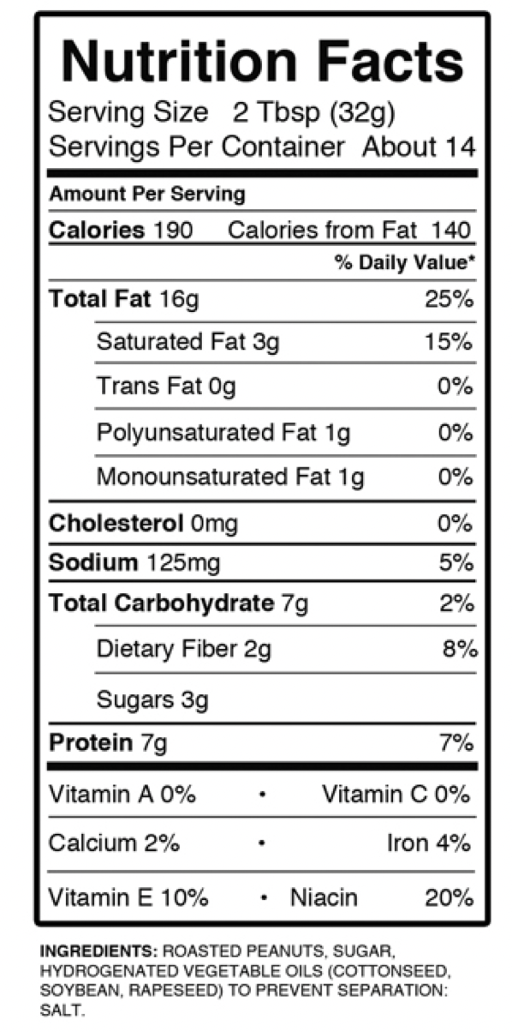
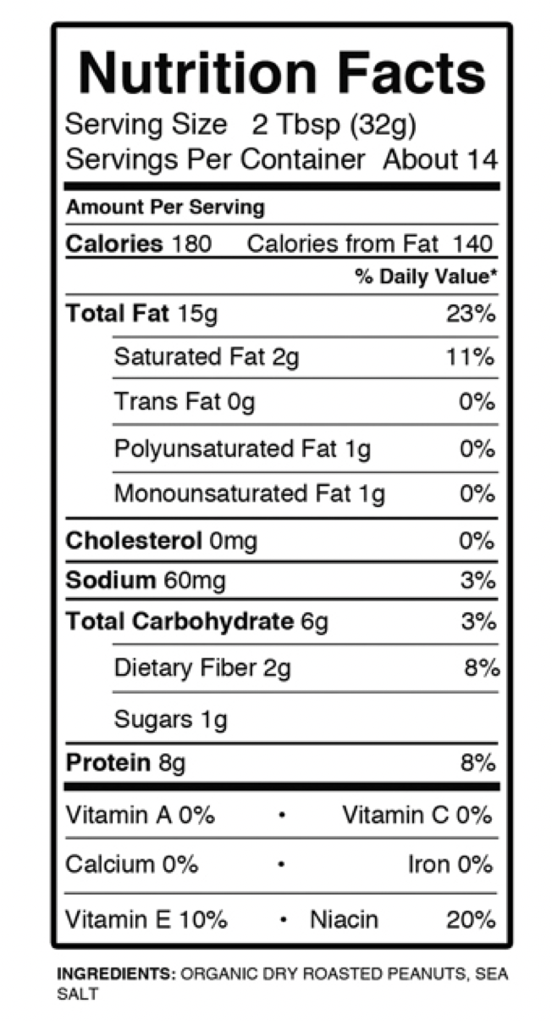
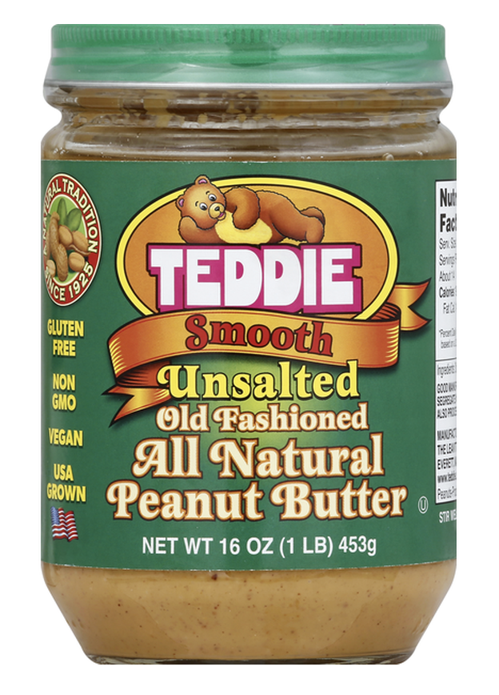
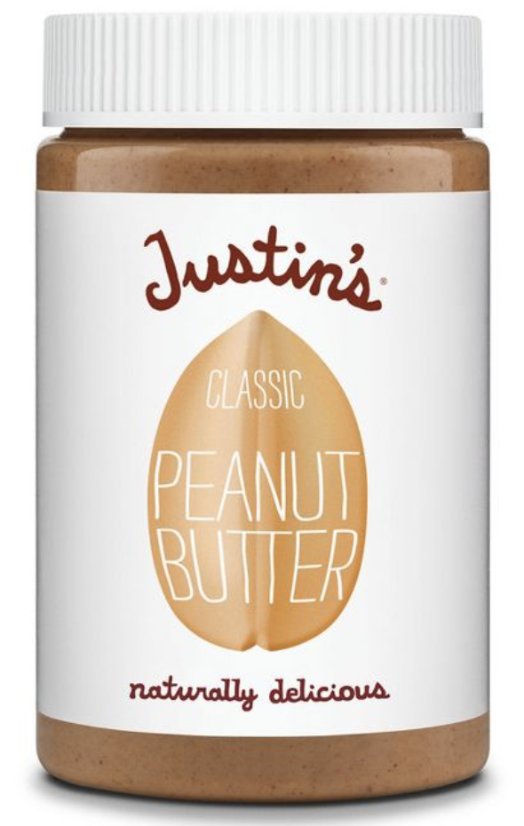
1
Which peanut butter would you choose and why?
2
Notes:
Look at the ingredients!
Label 1 has peanuts, sugar, and a blend of 3 highly processed poor quality hydrogenated oils
Label 2 has roasted peanuts and salt
You might not be able to catch this different if you just looked at the front of the jar

Slide 27
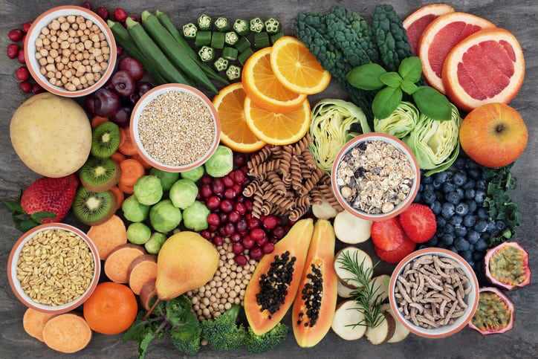
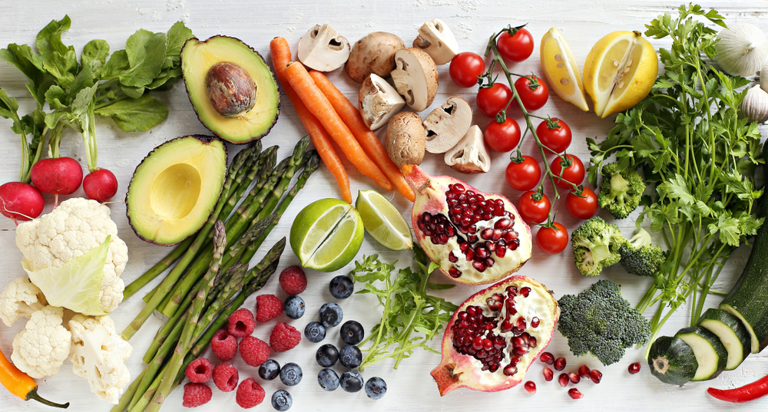
Whole Foods, Plant-Based Diets
A Beginner’s Guide

Slide 28
What is it?
A Diet consisting of minimally processed vegetables, fruits, whole grains, legumes, nuts, and seeds.
The Benefits - Many of the world’s leading causes of death such as heart disease, obesity, and cancer can be prevented by consuming a whole foods, plant-based diet. Additional benefits include:
More energy
Lower cholesterol and blood pressure levels
Preserved eye sight
Stronger, healthier bones
Decreased need for drugs and other medications
Lower risk for Alzheimer’s Disease

Slide 29
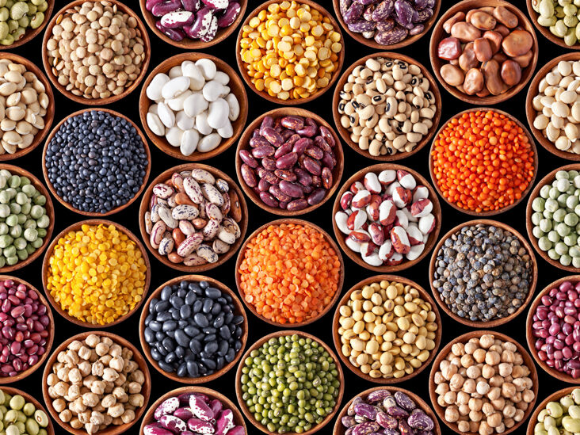
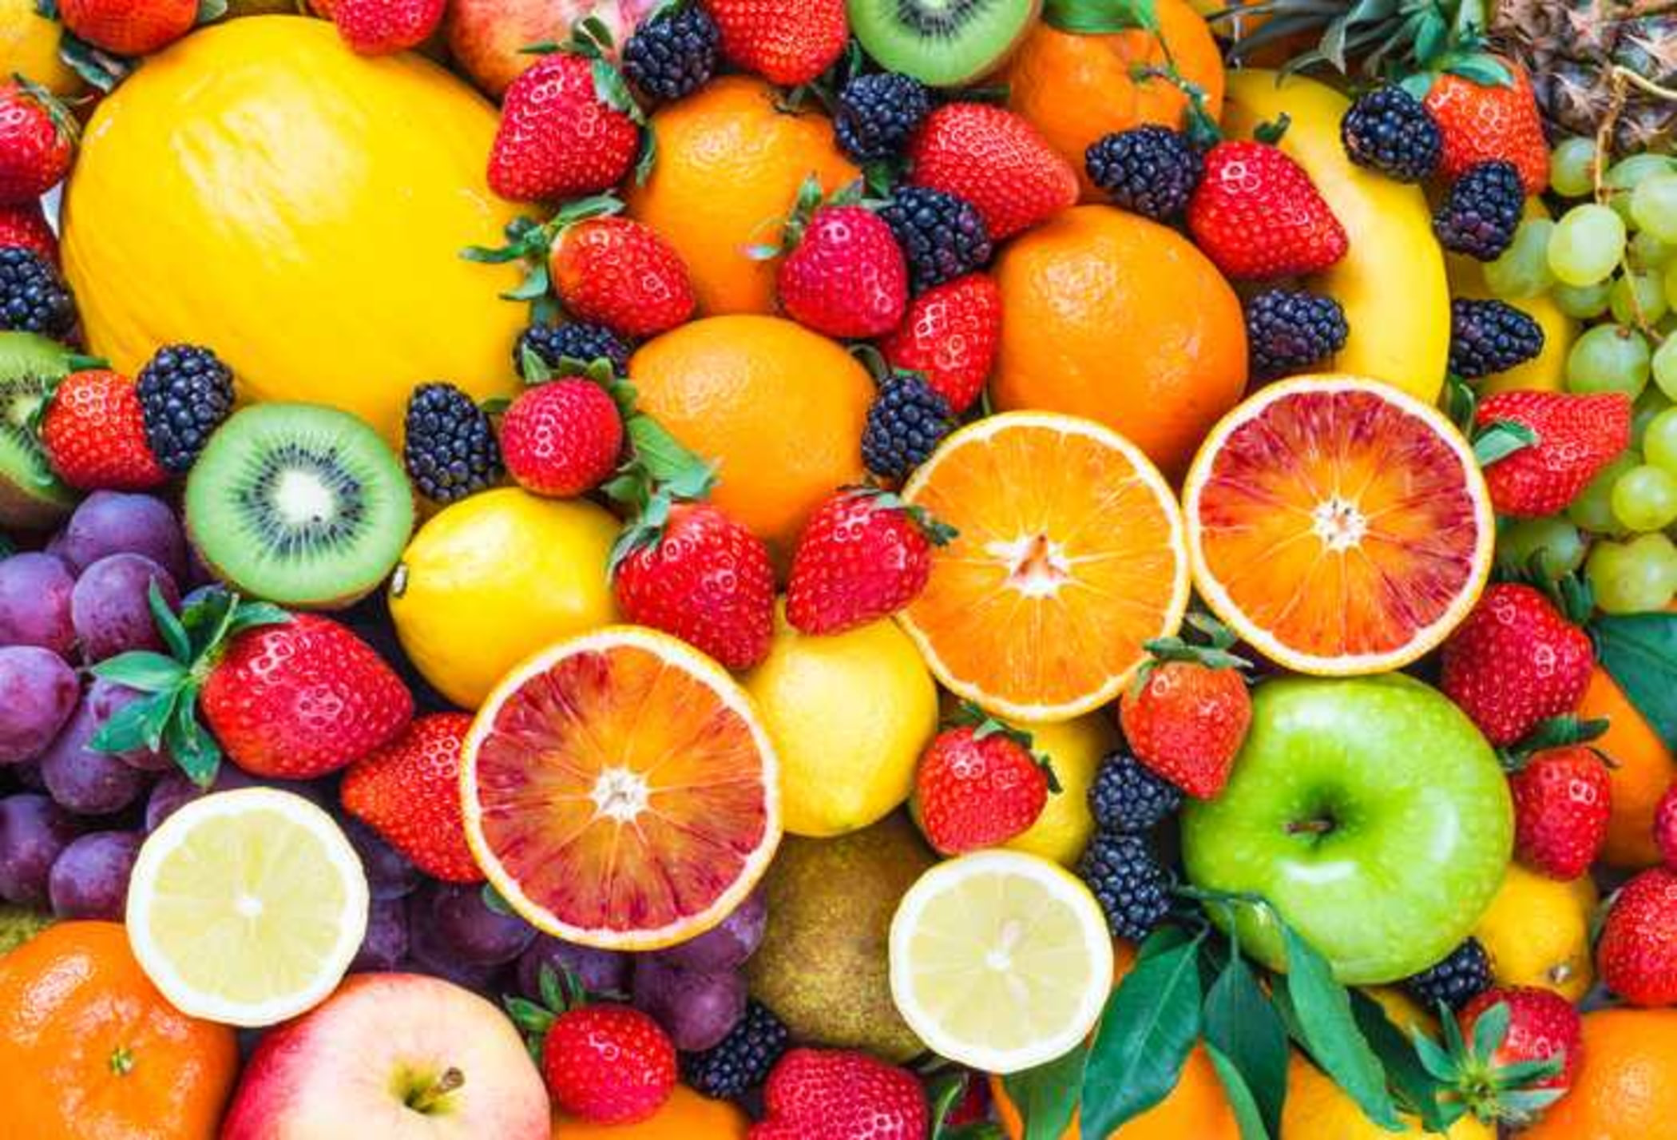
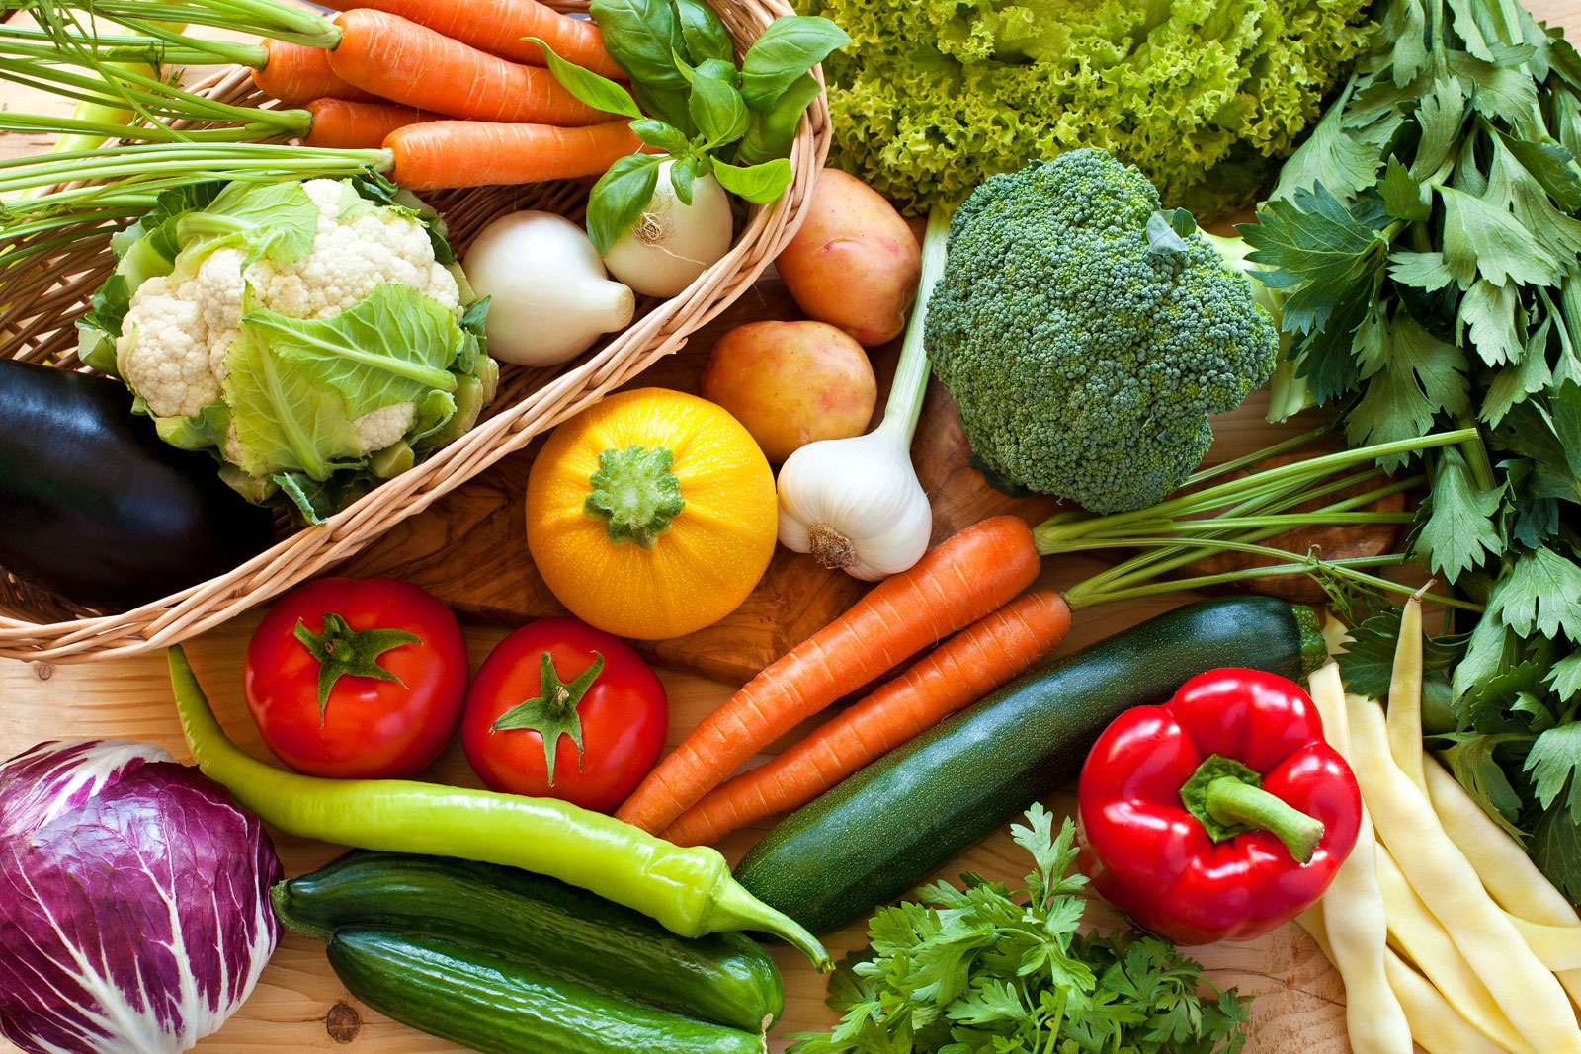
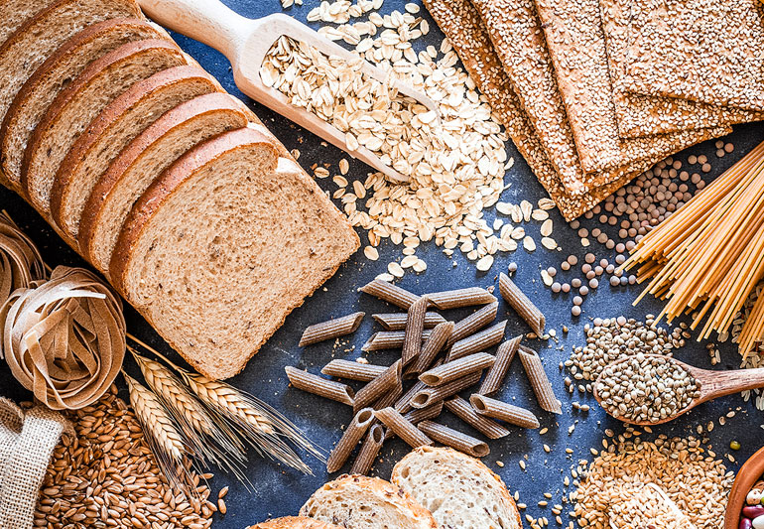
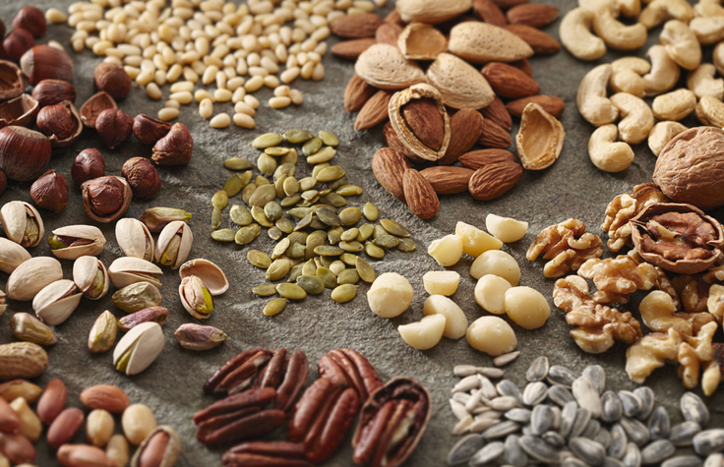
How to Eat Smarter
Eat/Drink LOTS of
1. Fruits
2. Vegetables
3. Legumes
4. Whole grains
5. Nuts
6. Seeds
7. Water
LIMIT/AVOID:
1. Sugary drinks
2. Processed meat and snacks
3. Cakes, pastries, sweets
4. Dairy
5. Red meats
6. Poultry

Slide 30
Strategies for Healthy Digestion
Digestion Starts in the Brain!

Slide 31
Digestion
Digestion is heavily influenced by the state of mind and environment we are in while eating.
Have you ever eaten food or a meal while:
In the car?
Talking on the phone?
Working at a desk?
Surfing the internet on your phone?
Watching TV?
While in a hurry?
All these activities have the potential to affect your digestion in a negative way!

Slide 32
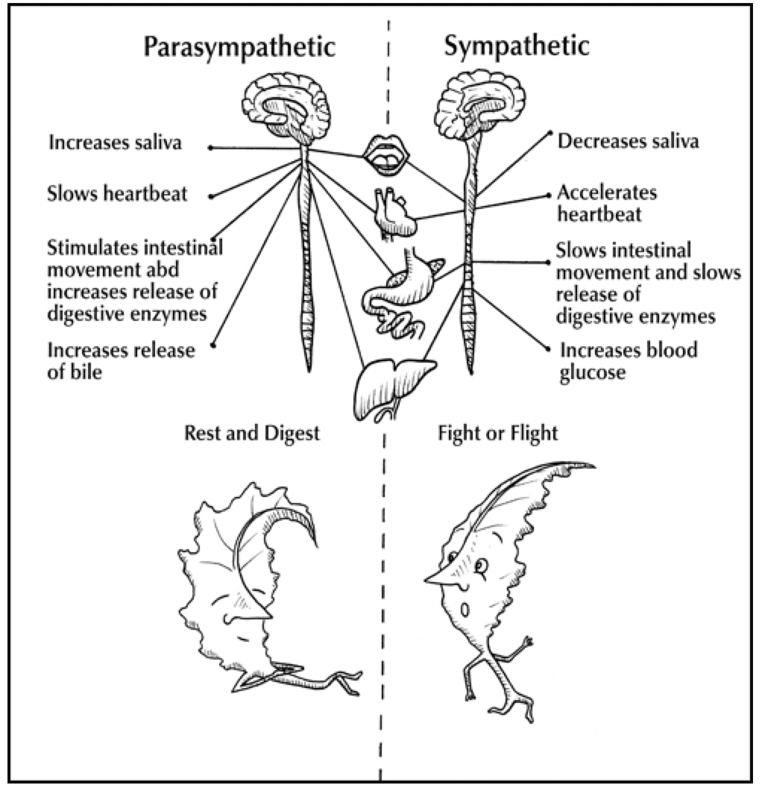
When we eat in a stressed state, our digestive processes are slowed or stopped.
In today’s world, many people are in a constant state of stress - leading to a chronic sympathetic state.
Notes:
Sympathetic state is known as fight or flight mode - classic example of when you are being chased by a bear, your body allows you to run faster and hit harder
While most people do not find themselves being chased by bears too often, we can apply the same physiological changes to all stressful situations
Notice what happens when the body is in a sympathetic state
This is what happens when we eat while rushing to work, dealing with stress, watching negative news or media
Parasympathetic state is the rest and digest mode - calm, low-stress environment with limited stimulation
Notice how digestion improves in this state
Decrease in digestive complaint such as gas and bloating
More likely to notice when we are full in this state

Slide 33
Strategies for Healthy Digestion
1. Turn off all electronic devices, including TV’s, phones, tablets, and computers during meals
2. Take time to put food on the plate and find a comfortable place to eat sitting down - not at a work desk
3. Take ten deep, slow breaths before beginning to eat (this is a powerful way to create a parasympathetic state)
4. Put the fork down between bites and focus on chewing
5. Limit fluid intake during meals
6. Practice mindful eating - avoid multitasking; just eat. Savor your food and take note of how you feel before, during, and after meals

Slide 34
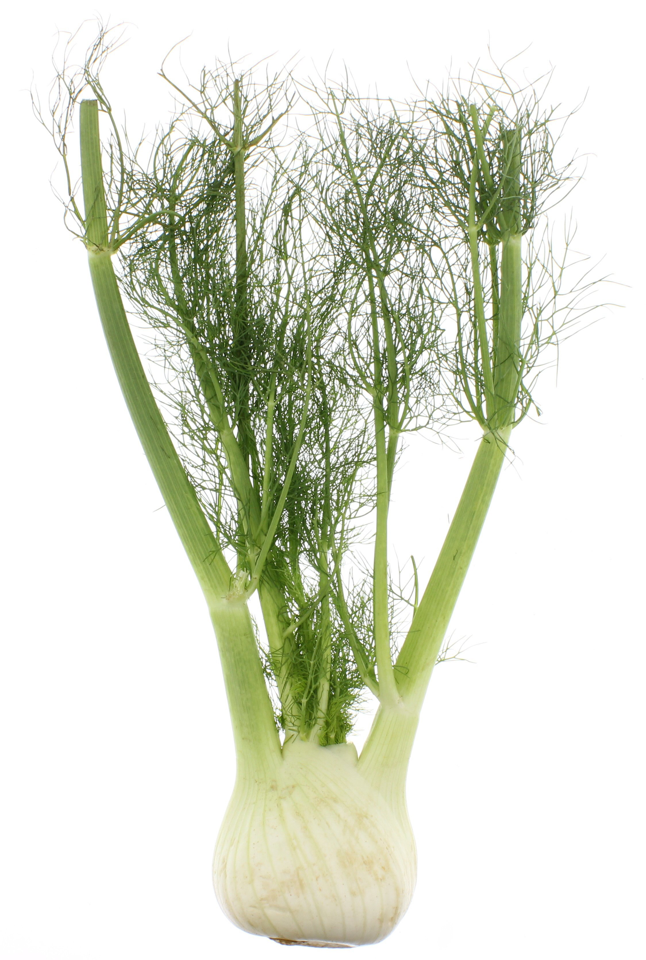
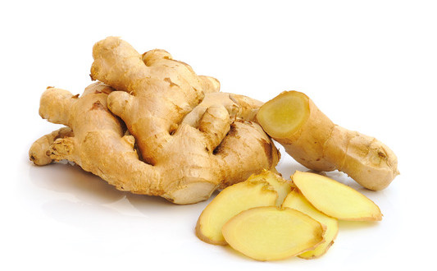
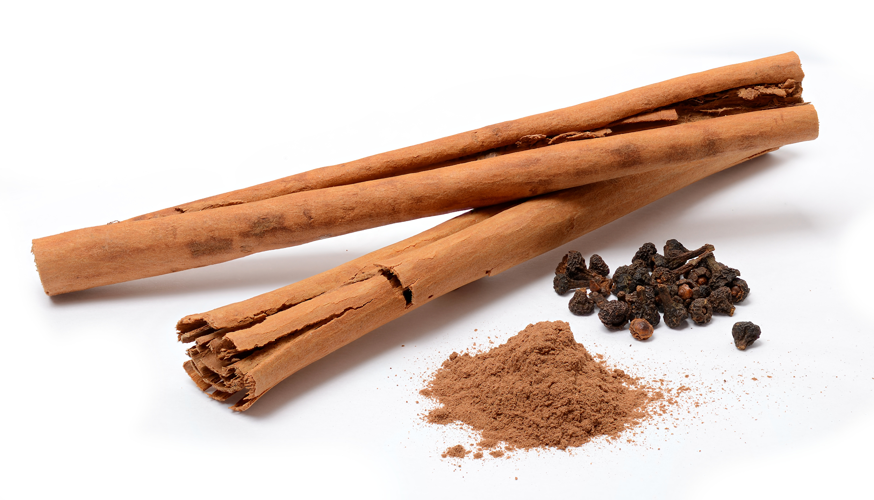
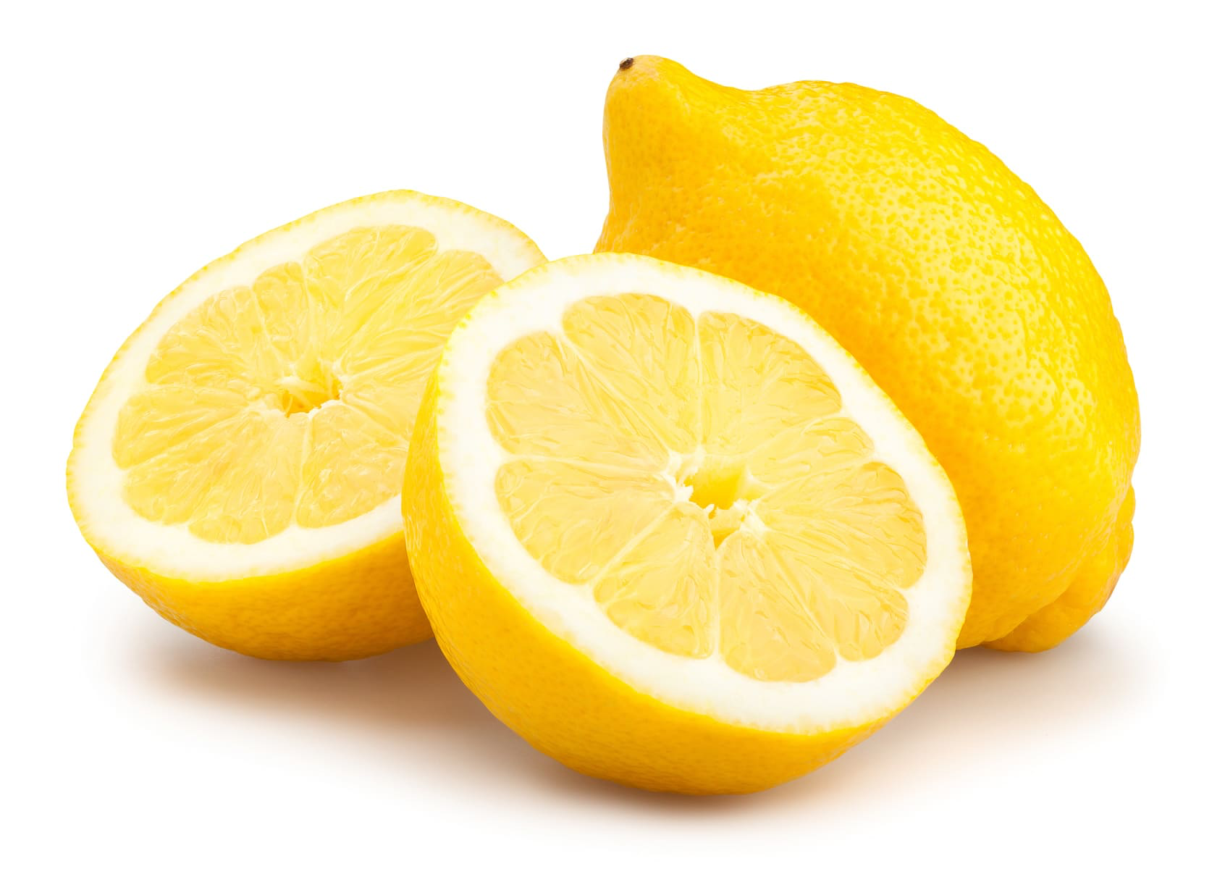
Indigestion Fighters
Feeling bloated or having indigestion? Try these!
Fennel
Ginger
Cinnamon
Lemon
Cayenne or black pepper
Apple cider vinegar
Lowers post meal blood sugar, slows carbohydrate absorption, and improves satiety
Notes:
can add these to smoothies, main dishes, etc

Slide 35
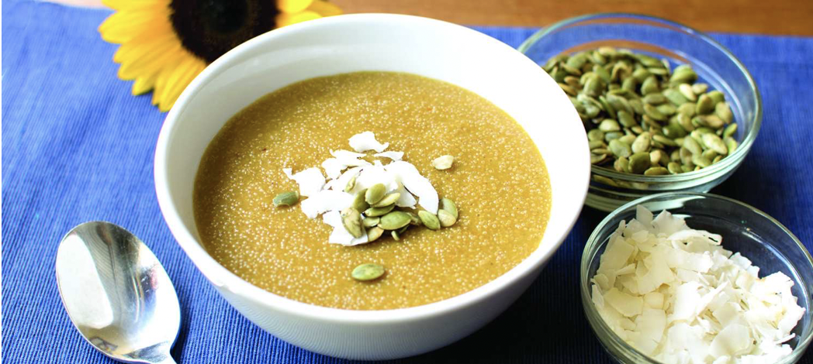
Healthy Habits
Breakfast, Water, Sleep, and More

Slide 36
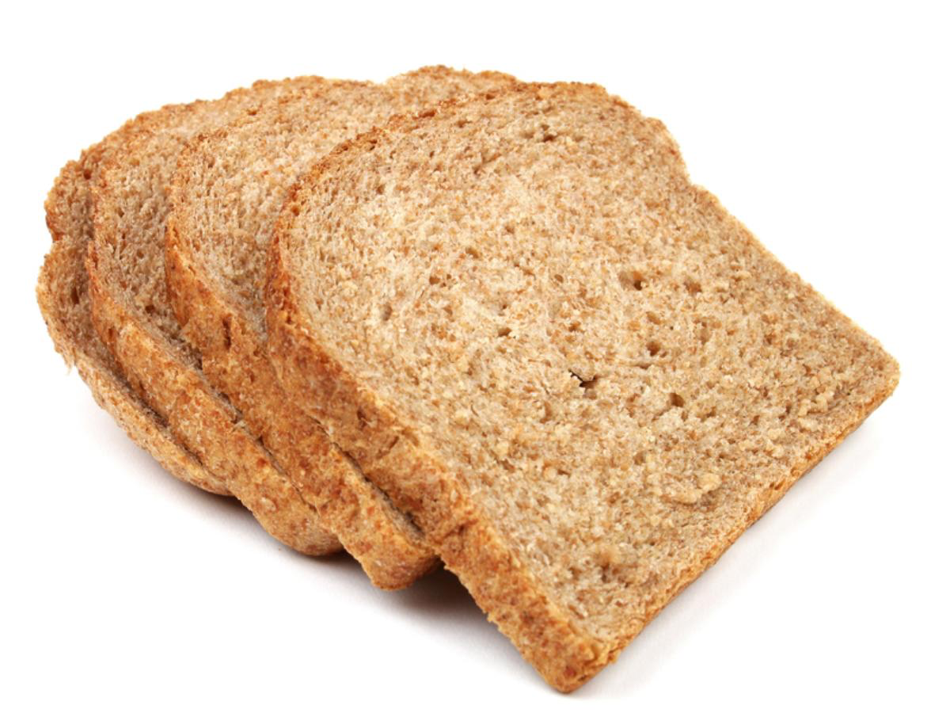
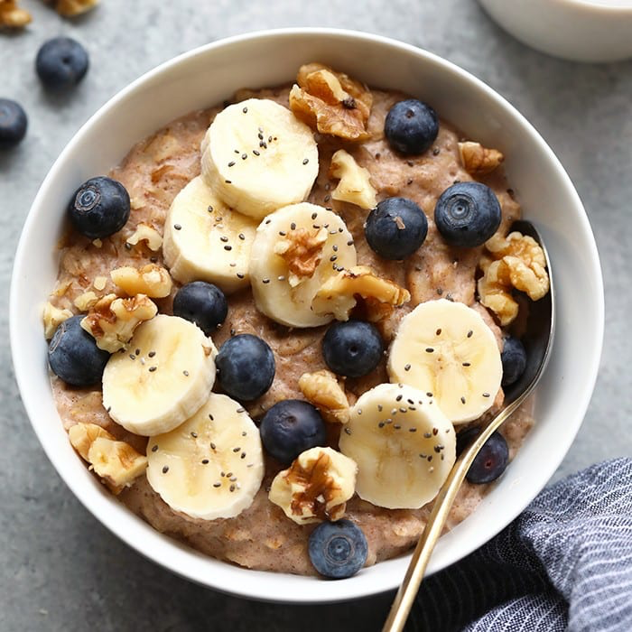
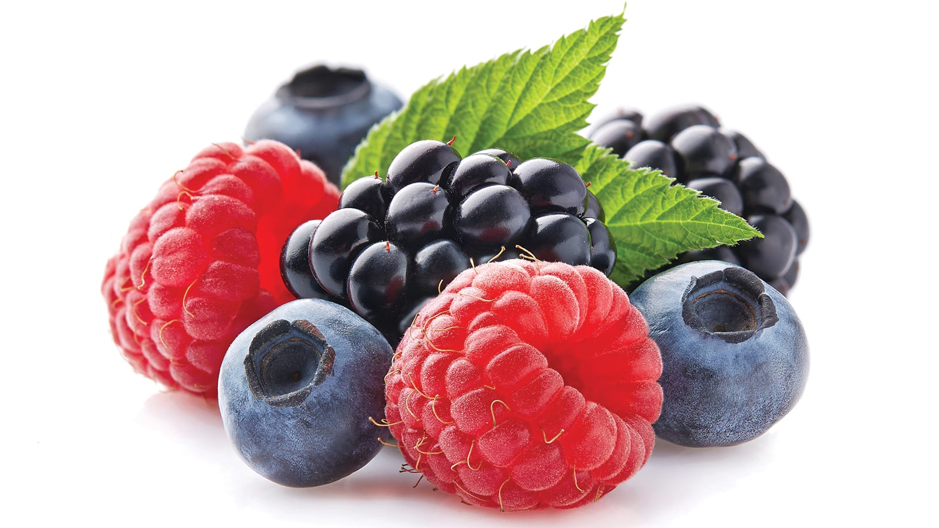
Breakfast
Eat within 1 hour of waking up
This will kickstart your metabolism and give your body fuel
If food is not eaten, the 10-12 hour fast your body has been in lengthens, which can be accompanied by fatigue, mood changes, and headaches
In order to reap the benefits of breakfast - no late night snacking
The Benefits of Breakfast Include:
Successful maintenance of weight loss
Increased focus, decreased stress, better work performance
Improved mood
Increased longevity - yes! Research has shown breakfast lengthens lifespan
Decreased risk of heart disease
Decreased risk of developing diabetes
Notes:
The word breakfast is a compound literally meaning the end of a fast from the night before
If we don’t eat when waking up, the fast is lengthened leading to negative side effects

Slide 37
Non-Breakfast Eaters
Strategies for those who don’t have time or don’t like to eat breakfast:
Go to bed 15 minutes earlier and wake up 15 minutes earlier in the morning
Make extra dinner the night before and package up leftovers for the next morning
Meal prep! Make a big batch of oats on Sunday and divide them into enough servings to get you through the week
Eating something is better than eating nothing
Grab a handful of nuts or a piece of fruit

Slide 38
Water & Sleep
Water:
Helps the body to hydrate, detoxify, maintain alertness, regulate body temperature, and protect joints and organs
Fatigue, mental fogginess, headaches, and dry skin can often be improved or solved by drinking more water
How Much Should I Be Drinking?
Drink half your weight measured in pounds, in ounces, everyday
If you weigh 150 lbs, you would aim for 75 ounces per day
Sleep:
While sleeping, the body recovers from the stress of the day and fights infection
Adults need 7 to 9 hours of sleep and children need 10 to 14
Problems Associated With Lack of Sleep:
Sleep deprivation leads to an increase in the hormone ghrelin, which increases the desire for sweet carbohydrates
It also increases the stress hormone cortisol, which impacts blood sugar and can lead to insulin resistance and weight gain
Notes:
Up until now we have strictly talked about food. However, a healthy life is built upon a combination of healthy habits that will compliment the healthy food choices we have been discussing
Water - the body is made up of 60-70% water
Sleep - up to 30% of U.S. population suffers from insomnia - characterized by difficulty initiating or maintaining sleep
This leads to several negative health effects

Slide 39
Tips for Better Sleep
1. Create a routine around sleep and wake cycles
Go to sleep and wake up at the same time every day
2. Sleep in a dark room
3. Avoid all caffeine after noon
4. Avoid alcohol
5. Don’t eat, drink, or work in bed - it’s meant for sleeping!
Notes:
The effects of caffeine can last up to 20 hours in some people
Sodas, energy drinks, tea
While you may think it's easier to fall asleep after drinking, alcohol actually disrupts the brain’s ability to enter deeper levels of restorative sleep

Slide 40
Breathing & Movement
Breathing:
Focusing on deep, quality breaths can reduce stress and support healthy blood pressure
Movement:
A habit of daily movement is critical for wellbeing
Our society is fighting a sitting disease
Diaphragmatic Breathing:
1. Find a quiet place to sit or lie down
2. Place one hand on belly
3. Begin by exhaling all breathe through the nose or mouth
4. Then, take a deep breath in through the nose, for a count of 5
5. Hold the breath for 1 more second
6. Exhale for a count of 5 and wait 1 second before restarting the cycle
Notes:
Sitting disease - many adults sit at work all day, kids sit at school all day, technology encourages a sedentary lifestyle
Long periods of physical inactivity (rather than simply just a lack of exercise) raise the risk of developing heart disease, diabetes, cancer, and obesity
The people most at risk are those who sit for 8 or more hours a day

Slide 41
Combat Physical Inactivity
Set a reminder to move your body every 45 to 60 minutes
Stretch, do a couple full body exercises, climb the stairs, walk around
Stand instead of sitting! On the phone, reading, answering emails
Walk up the stairs instead of the elevator
Park at the back of the parking lot
Carry groceries to your car instead of pushing a cart
Bike to work
Enjoy gardening, yard work, and cleaning
Reduce screen time
Play with your kids
Walk! It is one of the best ways to reduce fatigue and improve mood

Slide 42
Eating On The Go & Grocery Shopping

Slide 43
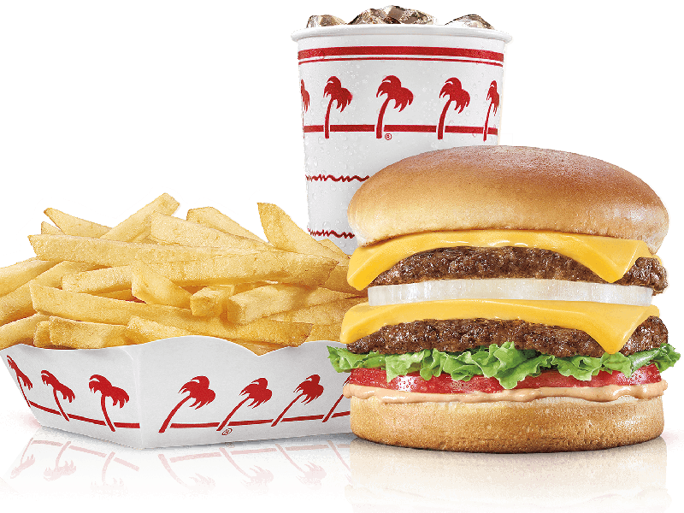
Healthy Eating On The Go
The Problem With Fast Food On The Go:
Tends to be higher in calories with more than 50% of those calories coming from saturated and trans fat
Low in nutrients (iron, calcium, riboflavin, vitamin A, vitamin C)
Difficult to remain in parasympathetic state on the go
Leads to digestive distress

Slide 44
Make the Most Out of Fast Food
Seek out whole grains and legumes - look for a salad bar
Drink water with your meal, not soda
Limit mayonnaise, ketchup, creams, and dips
They often contain high-fructose corn syrup and unhealthy fats
Slow down while you eat
Avoid supersized and adult-sized portions because of the high caloric nature of fast foods
Don’t be shy! Ask for the ingredients list and nutritional data
Limit or avoid saturated fats found in sausages, bacon, and ready made meat
Notes:
Bullet 1 - some fast food restaurants offer brown rice instead of white rice, refried beans, or black beans
Bullet 2 - avoiding all soda, juice, and sweetened tea is one of the best decisions to make while eating out at fast food restaurants
Consider adding lemon to water for taste
Do not add salt to your food
Don’t skip meals - you risk low blood sugar and increased craving for quick, sugary or salty food
you don’t have to do every single one of these tips every time you eat out, just start off by trying one

Slide 45
General Grocery Shopping Tips
1. Do not go grocery shopping hungry
2. Always make lists before going shopping - list the meals to be made and the most important items
3. Start purchasing mostly unprocessed whole food plant based options: fruits, vegetables, mushrooms, whole grains, bean, nuts, seeds.
4. When healthy products you use often are on sale, buy them
5. Buy in bulk when you can
Notes:
when you shop hungry, you are more likely to make impulse buys and purchase unhealthy foods
6 - common dry bulk items are dry beans, whole grains such as bread (can go in freezer), flour, herbs and spices, raw nuts
Generally cheaper

Slide 46
Top 5 Superfoods to Have in Your Cart
1. Vegetables
Dark leafy greens are one of the most important nutrient dense foods
Spinach, collards, kale
Squash
Cruciferous vegetables
Cabbage, brussel sprouts, broccoli, Bok choy, cauliflower, collards
Beets
Garlic and onions
3. Healthy Fats
Avocados
Nuts and seeds
Pecans, walnuts, almonds, macadamia
4. Beans and Legumes
Black beans, kidney beans, lentils
2. Fruits
Berries
Citrus fruits
Melons
Apples and Pears
5. Fermented Foods
Soy products - Tofu, Miso, plant-based milks
Notes:
cruciferous - kroo-sif-eres

Slide 47
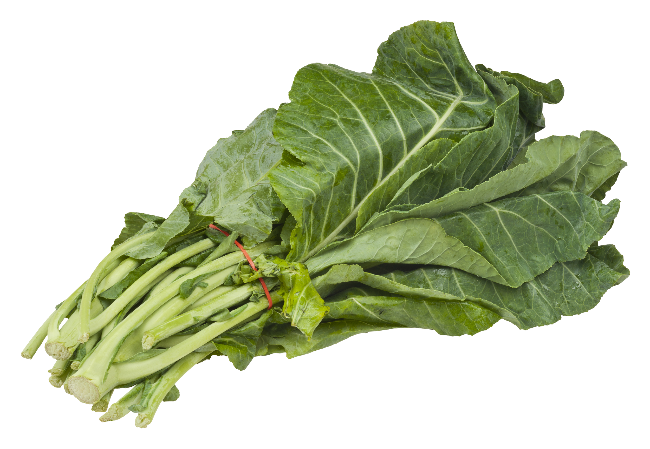
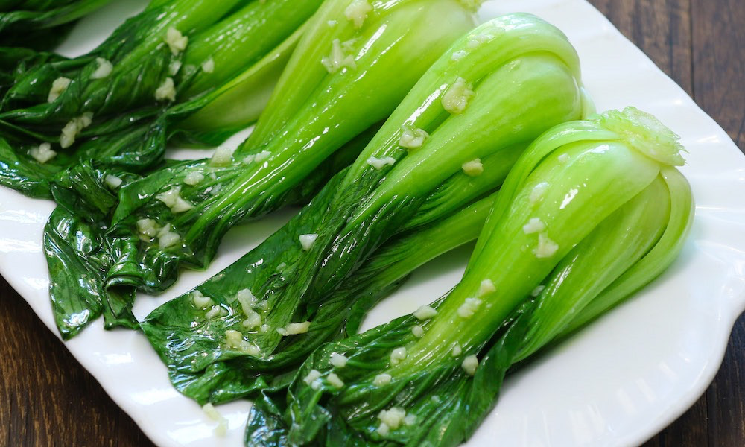
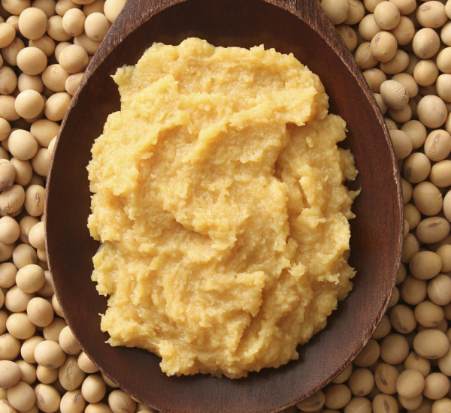
Bok Choy
Collards
Miso
Notes:
When I started reading about what I should be putting in my cart, I had never heard of some of the food items. This will help you put an image to some of them.

Slide 48
Foods to Limit/Avoid
Excess Added & Artificial Sweetener
High fructose corn syrup, soda, juices, condiments
Refined Carbohydrates
Sugar
Whole grains processed to remove the bran and germ
Enriched wheat flour, white rice, white bread, fruit juice, corn syrup
Trans Fats and Partially Hydrogenated Oils
Packaged snacks, frozen french fries, fast foods, fried foods
Omega-6 Fatty Acids
Processed oils and animal products (meats, dairy, fish, and eggs)
Highly Processed Foods
Canned soups, frozen dinners, boxed foods, pre-made sauces, salad dressing
Notes:
Refined carbs - this ingredient sneaks up in most packaged foods
When the brain and germ (the most nutritious parts) are removed
Enriched wheat flour, white flour, fruit juice, corn syrup
Trans fats - read the food labels!
Oils that have been chemically modified to keep them from going rancid
There is no safe amount of trans fat
Remember if there is less than .5 grams in a product, the company does not have to list it on the label
Look for partially hydrogenated oils
Omega-6 - americans over consume
Try for omega-3 such as chia seeds, walnuts, flaxseed

Slide 49
Organic or Not Organic?
The Dirty Dozen - high amount of pesticide residue on fresh produce
Apples Snap Peas
Peaches Potatoes
Nectarines Hot Peppers
Strawberries Kale
Grapes Collard Greens
Celery
Spinach
Sweet Bell Peppers
Cucumbers
Cherry Tomatoes
The Clean Fifteen - lowest amount of pesticide residue on fresh produce
Avocados Eggplant
Sweet Corn Grapefruit
Pineapples Cantaloupe
Cabbage Cauliflower
Sweet Peas Sweet Potatoes
Onions
Asparagus
Mangos
Papayas
Kiwi
Notes:
Put out by the Environmental Working Group and updated every year - this is from 2015
If you are deciding what to buy organically, buy from the dirty dozen

Slide 50
Final Thoughts
We obviously cannot eat 100% healthy and avoid fast food every single day of our lives. HOWEVER, everyday we are faced with choices that can improve or hurt our health. It is never too late to start changing your choices.
Plant-based and whole foods are proven to decrease the risk of diabetes, heart disease, obesity, and cancer. What changes are you going to make starting today?

