Slide 1
The New You

Slide 2
Objectives
Where were we?
Where are we now?
Next Steps
Final thoughts
Please remember: The Content is not intended to be a substitute for professional medical advice, diagnosis, or treatment. Always seek the advice of your physician or other qualified health provider with any questions you may have regarding a medical condition.

Slide 3
Where were we?
Goals
Improve health behaviors and well-being
Take personal responsibility for our health
Commit to the Challenge
Make Progress
Eat Smarter
Move More
Manage Stress Better
Sleep More Soundly
Cultivate Relationships
Avoid Risky Substances

Slide 4
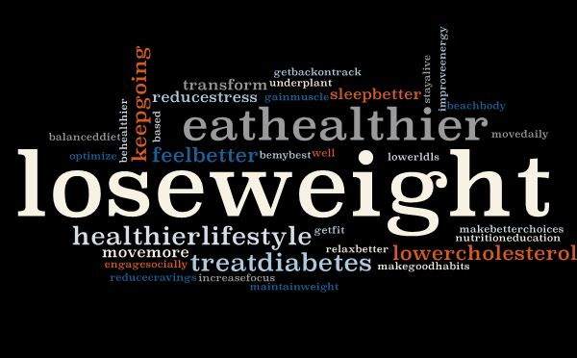
Our Health Goals

Slide 5
Where are we now?
Raise your hand if you are…
Eating more plant-based foods
Moving more frequently
Sleeping more soundly
Managing stress better
Maintaining healthy relationships
Avoiding/limiting alcohol and tobacco
Feeling better
Happier
More aware of your food and your lifestyle choices
On a path to improving your health!
What else?

Slide 6
What’s next?
Progress
Continue progressing and improving your future health!

Slide 7
Stay focused
For many Americans, their health journey looks more like this.
Decline

Slide 8
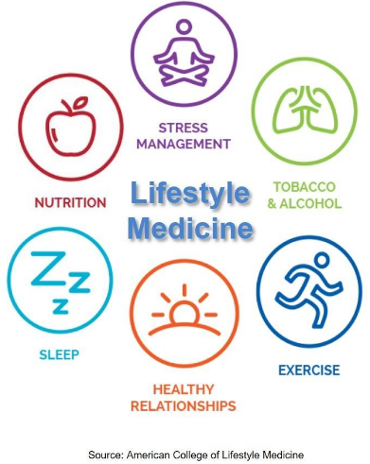
Next Steps
Our health is the sum of
What we eat
How we manage stress
The relationships around us
How we sleep
Avoiding toxic substances
Moving our bodies

Slide 9
Assess - Evaluate current habits and think about how you would like things to be different.
Purpose - Find your why for wanting to make a healthy change.
Prioritize - What do you need to do to make stress management a priority in your life?
Mindset - Determine how you will choose to think about your change efforts.
Game Plan - Determine what is required and what strategies would yield the great return/reward. Set a SMART goal.
Action - Put the game plan into motion and implement strategies you came up with to help you achieve your goal.
Reflect - Think back on what you accomplished and what you learned from the experience.
Improve - Continue to progress and consider using this strategy to improve in another area of your life.
Lead - Lead by example and serve others.

Slide 10
Ongoing Support
Continue using our website and resources at www.transformlm.org.
Find all of our challenge materials posted under the Challenges tab
Check out our social media (linked on website), blogs, and more! We currently have Facebook and Instagram accounts
Come See Karen or Bryanne at Progressive Health in Wilmington DE.
Stay tuned for more information and our next challenge!

Slide 11
Keep Learning
Movies:
Game Changers, Forks over Knives, What the Health, Cowspiracy
Books:
How Not to Die, Proteinaholic, Prevent and Reverse Heart Disease, the Mindful Vegan, Undo it, Sick to Fit, Blue Zones Solution, The China Study, How Not to Diet, Dr. Neal Barnard’s Program for Reversing Diabetes, The Cheese Trap, The Mad Cowboy
Websites:
www.pcrm.org, www.nutritionfacts.org, www.transformlm.org, www.pbhsg.org
Podcasts:
Plant Yourself, Exam Room Podcast, Veggie Doctor Radio, Rich Roll, Heart Doc VIP, No Meat Athlete, Plant Proof Podcast, Plant-Strong
Recipes:
www.lighter.world.com, www.fatfreevegan.com, www.forksoverknives.com

Slide 12
Final Thoughts
As a nation, we are not doing well. But YOU can improve your health and thrive.
Medications, procedures and pills are not always the answer.
Fill your plate with whole foods from the power plate.
Disease prevention and reversal can be accomplished with lifestyle changes!

Slide 13
Thank you for allowing us the opportunity to help you throughout our first Transform Health Challenge. Continue taking personal responsibility for your health. You deserve to live a healthy and happy life!

